Slide 1
Negative muons for Heritage Science: background and applications
Matteo Cataldo, Phd
MELODY, CSNS
11/01/2024

Slide 2
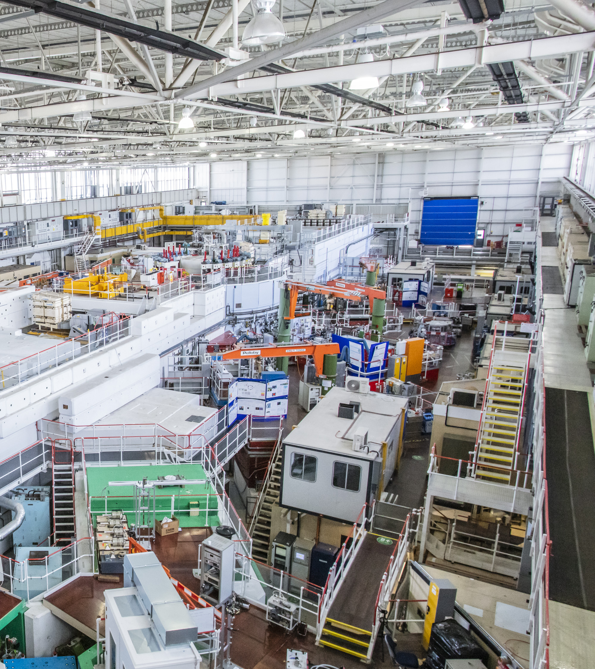


2
M. Cataldo – Negative muons for Heritage Science: background and applications, MELODY, CSNS 11/01/2025
Agenda
Introduction: scientific background
Research with negative muons: activities @ Milano Bicocca
Conclusions

Slide 3

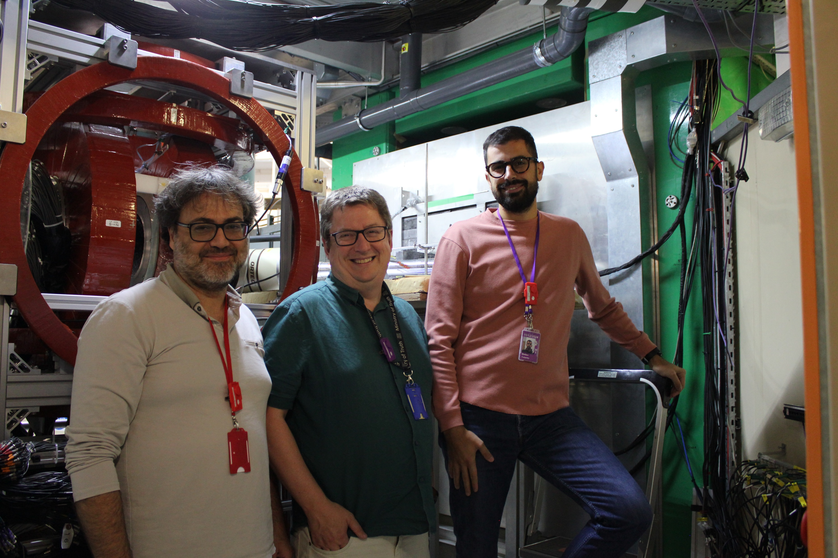
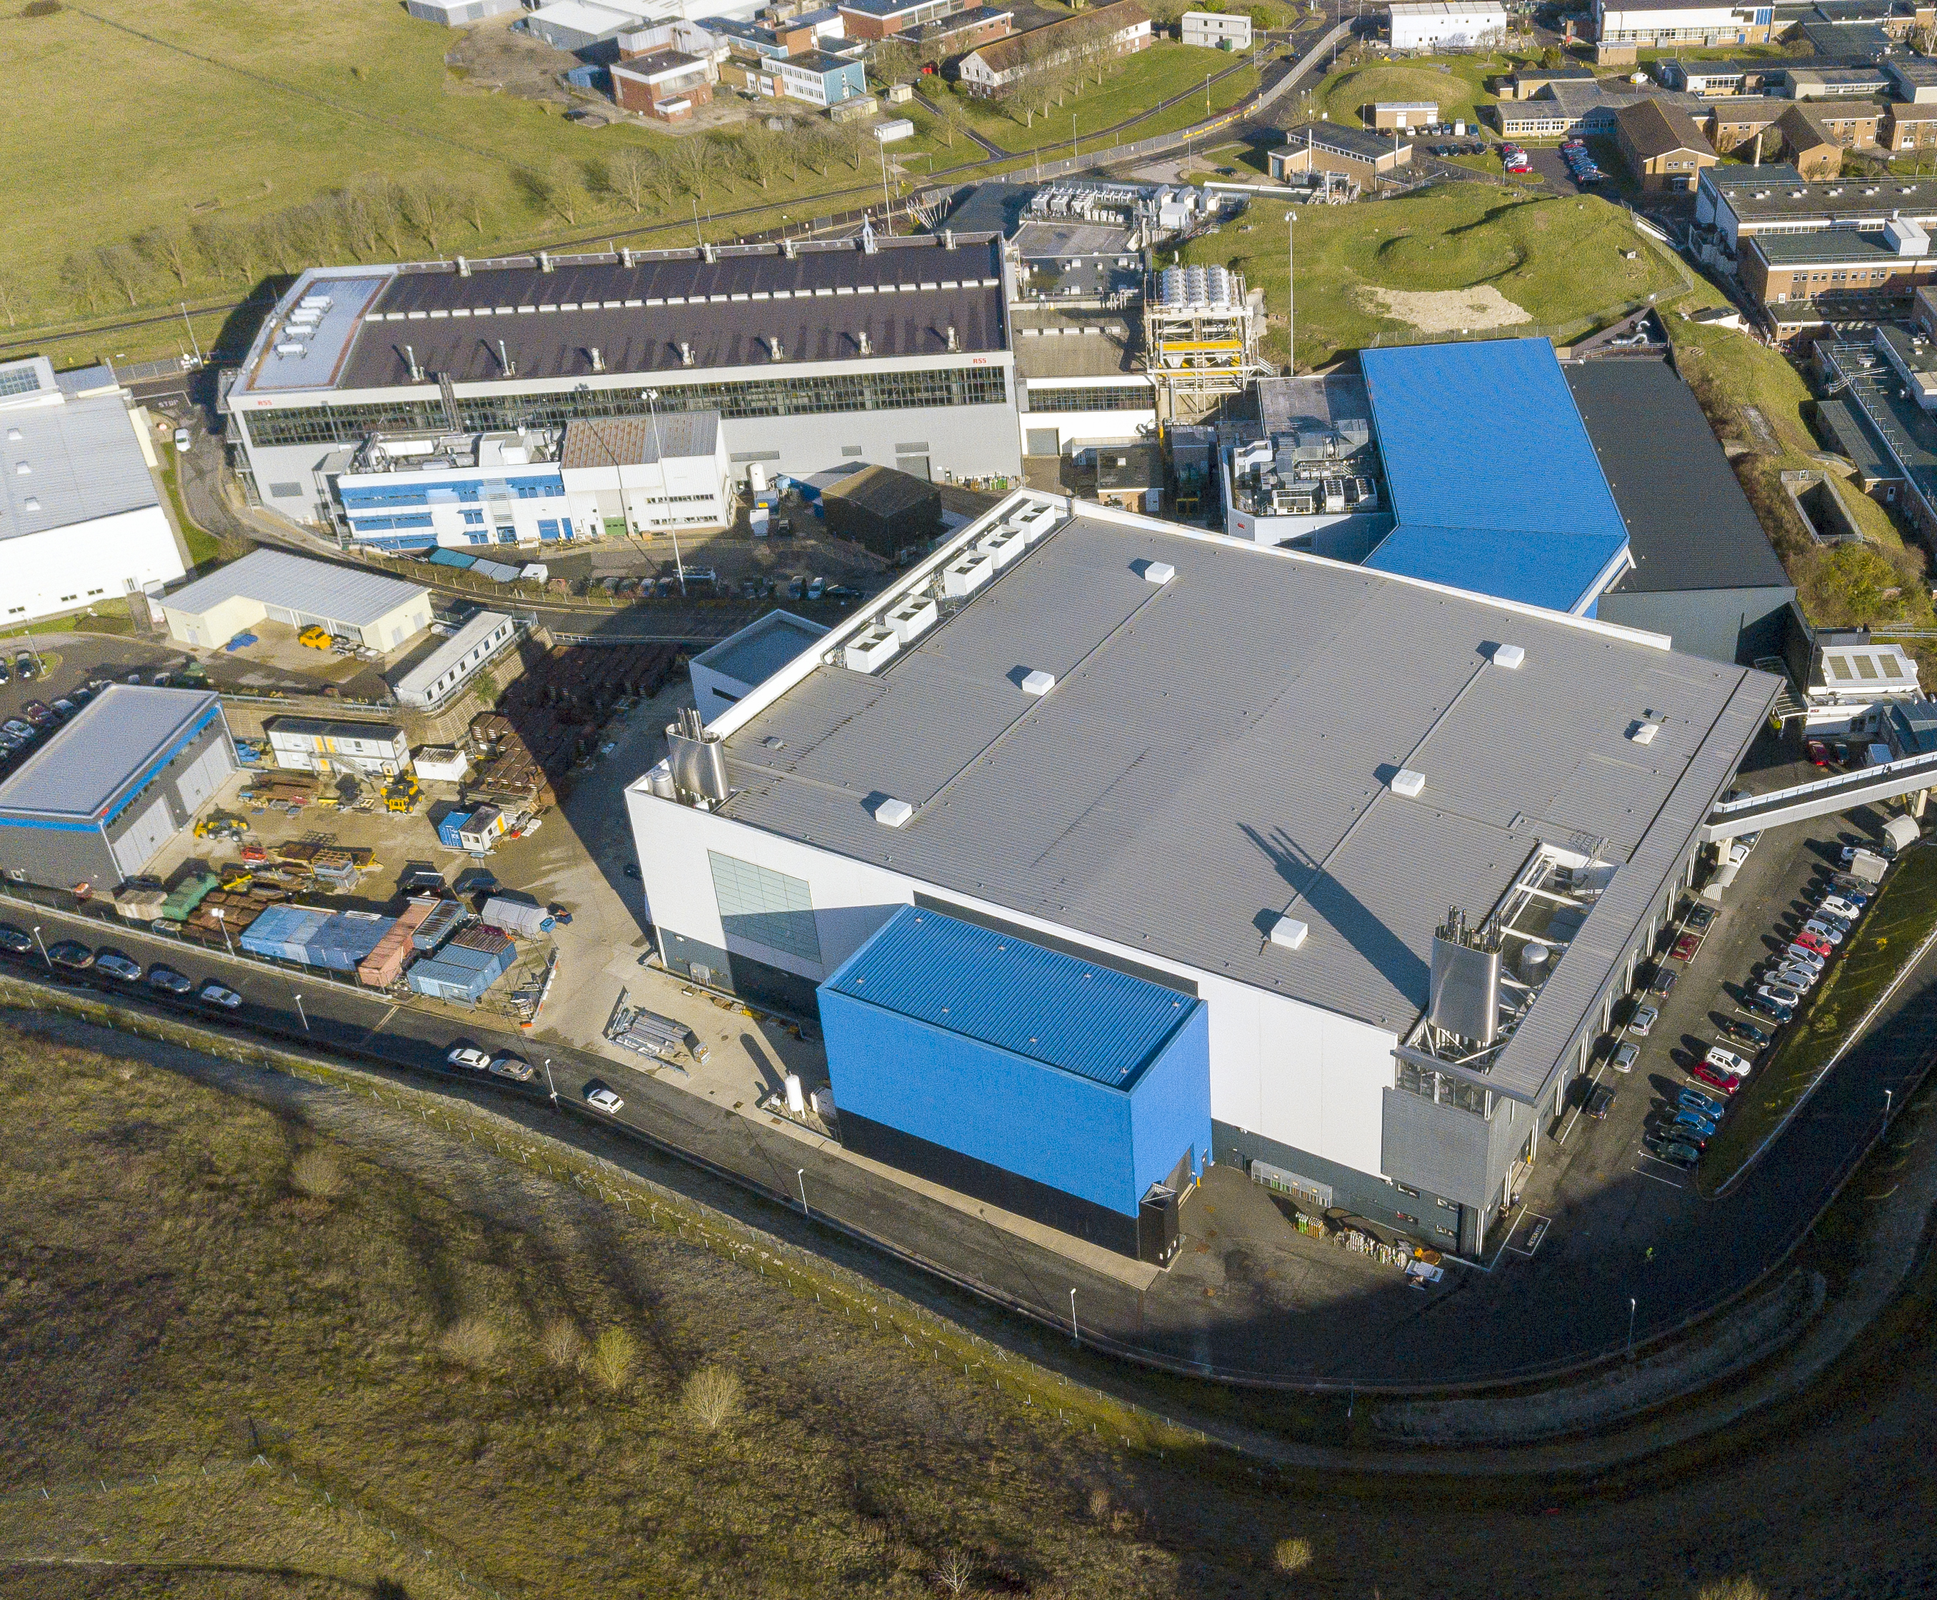
3
M. Cataldo – Negative muons for Heritage Science: background and applications, MELODY, CSNS 11/01/2025
About me: research fellow @ Milano Bicocca
University of Milano Bicocca
Me!
Max
ISIS Neutron and Muon Source
Aidy
Notes:
I’m a former facility development phd student at the ISIS Neutron and muon source, with a cofunded phd project with the university of milano bicocca

Slide 4
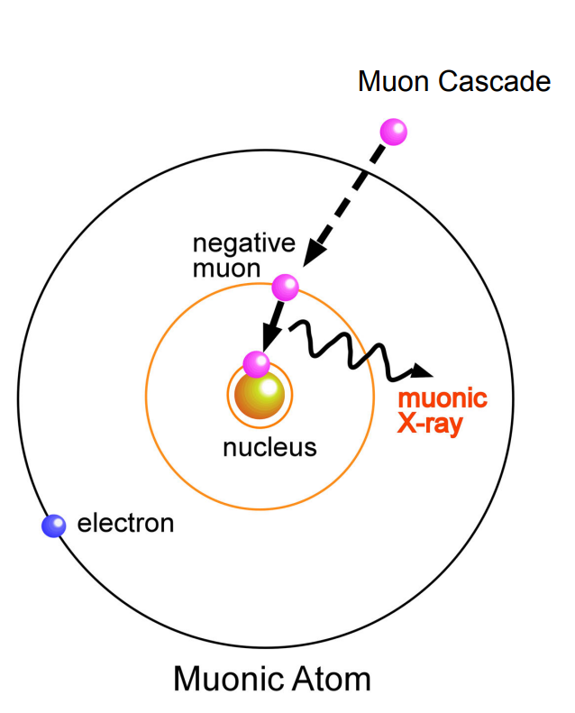
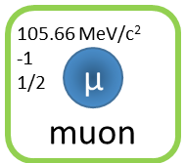
Introduction: negative muon interaction with matter
4
M. Cataldo – Negative muons for Heritage Science: background and applications, MELODY, CSNS 11/01/2025
When a µ⁻ interacts with matter, a “Muonic atom” is formed¹
Capture generally occurs at n ≈ 14;
First part of the cascade: Auger emission;
From n ≈ 6, characteristic radiative X-ray emission becomes dominant (elemental analysis);
The muon reaches the 1s state: decay or capture by the nucleus;
Muonic atom X-ray Emission spectroscopy (µ-XES)
is the technique based on the detection of these high energy radiation
¹ Hillier, A.D., Blundell, S.J. et al. Nat Rev Methods Primers 2, 4 (2022). https://doi.org/10.1038/s43586-021-00089-0
Notes:
Muon is slowed down and captured by the coulomb field of the nucleus
outer atomic electrons of the atom until it is captured by the Coulomb field of the nucleus.
Due to the mass of the muon, it will orbit 207 times closer to the nucleus, thus experiencing
207 times higher binding energies.

Slide 5
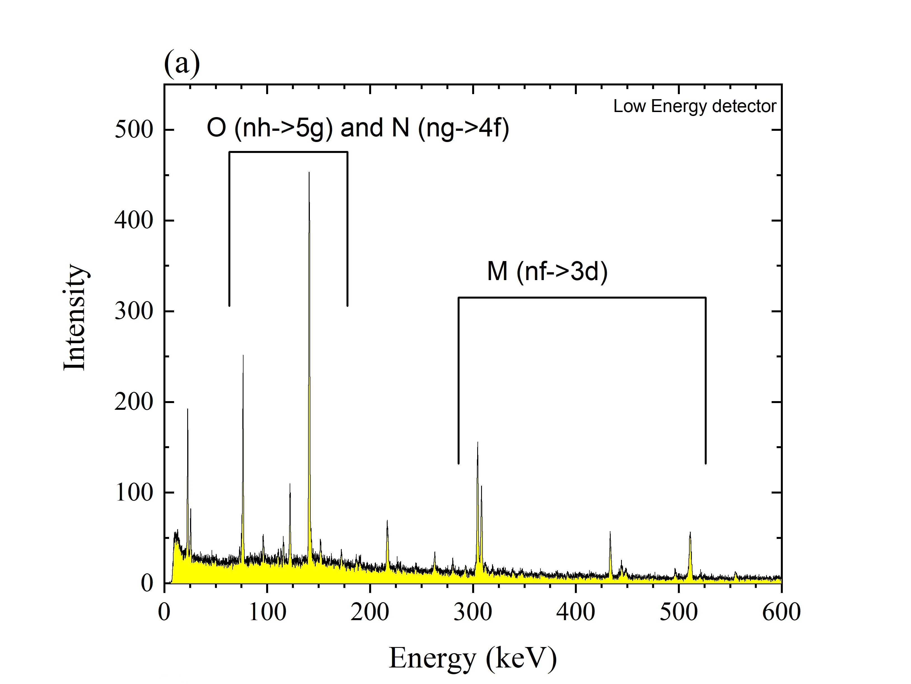
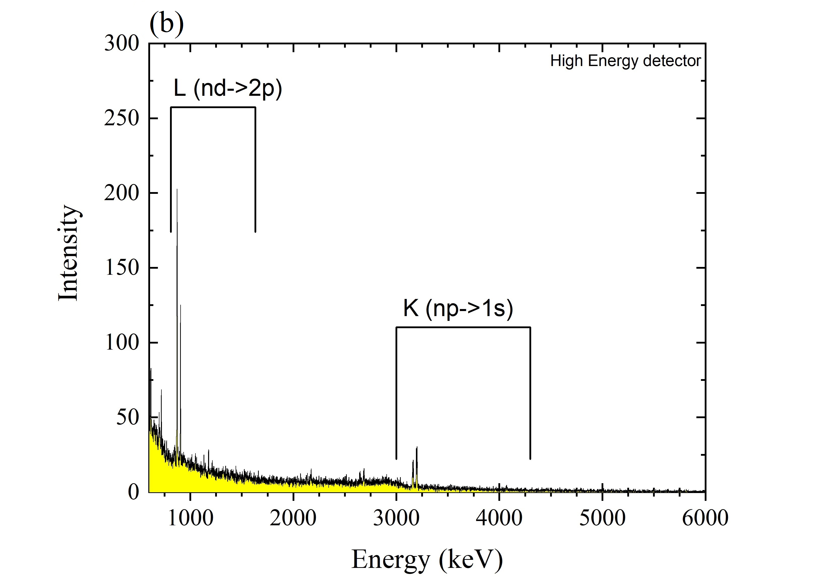
Introduction: negative muon interaction with matter
5
M. Cataldo – Negative muons for Heritage Science: background and applications, MELODY, CSNS 11/01/2025

Slide 6
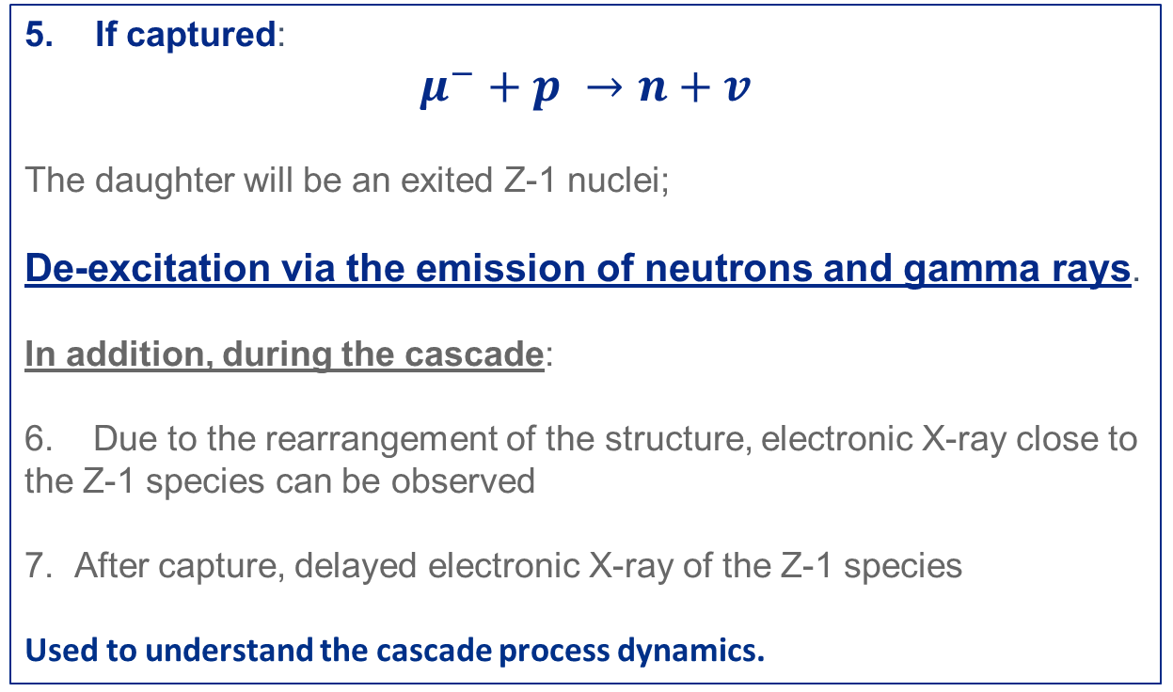
Introduction: negative muon interaction with matter
6
M. Cataldo – Negative muons for Heritage Science: background and applications, MELODY, CSNS 11/01/2025
When a µ⁻ interacts with matter, a “Muonic atom” is formed¹
If captured:
$μ^{−}+p →n+v$
The daughter will be an exited Z-1 nuclei;
De-excitation via the emission of neutrons and gamma rays.
In addition, during the cascade:
6. Due to the rearrangement of the structure, electronic X-ray close to the Z-1 species can be observed
7. After capture, delayed electronic X-ray of the Z-1 species
Used to understand the cascade process dynamics.
¹ Hillier, A.D., Blundell, S.J. et al. Nat Rev Methods Primers 2, 4 (2022). https://doi.org/10.1038/s43586-021-00089-0
Notes:
Hence, the reaction produces an exited Z-1 nuclei that will deexcite via the emission of neutrons and gamma rays. These gamma rays can be used for isotope identification since they are characteristic of the emitting species

Slide 7
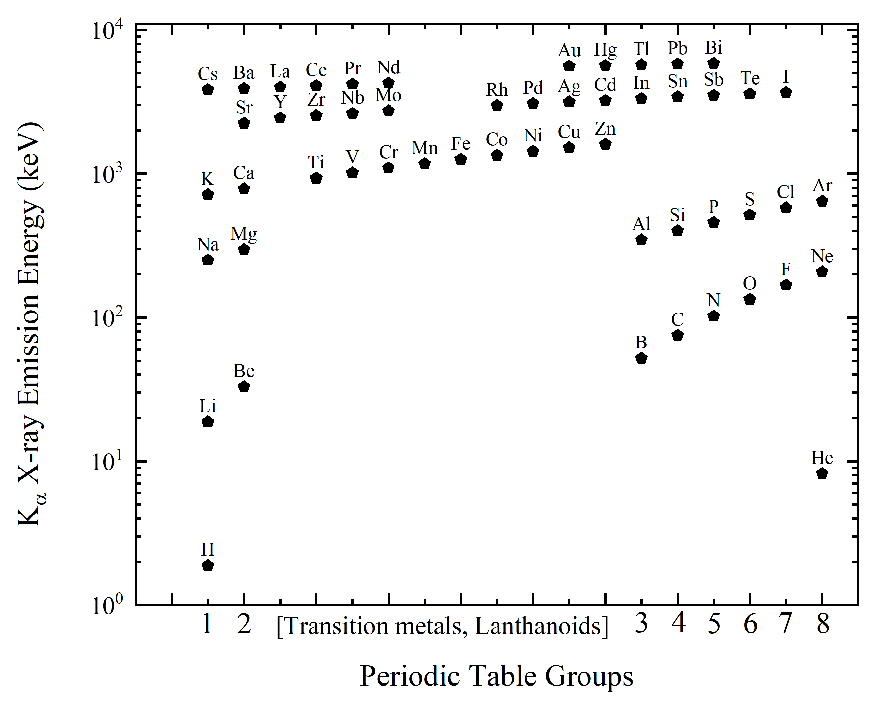

Introduction: µ-XES – Why?
7
M. Cataldo – Negative muons for Heritage Science: background and applications, MELODY, CSNS 11/01/2025
Multi-elemental
Remarkable penetration depth Momentum & Density dependent
m = 105.7 MeV/c²
Non-invasive probe
No activation of samples
Negligible self-absorption effect
Notes:
1 cm in copper and silverWhy muon have remarkable penetration depth (if compared to electron)
Different interaction, energy is lost by ionization and radiation instead of brehmstralung
Thanks to the mass, they are less effected by electromagnetic forces
Smaller cross section than electrom, less likely to interact
. Being able to probe non-destructively a lithium battery, will enable a better understanding of the mechanism and limiting factors for battery dis(re) charge.

Slide 8
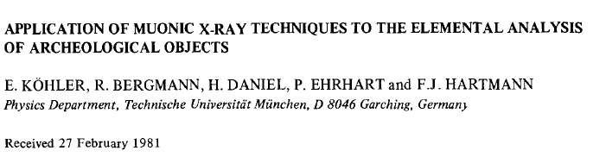
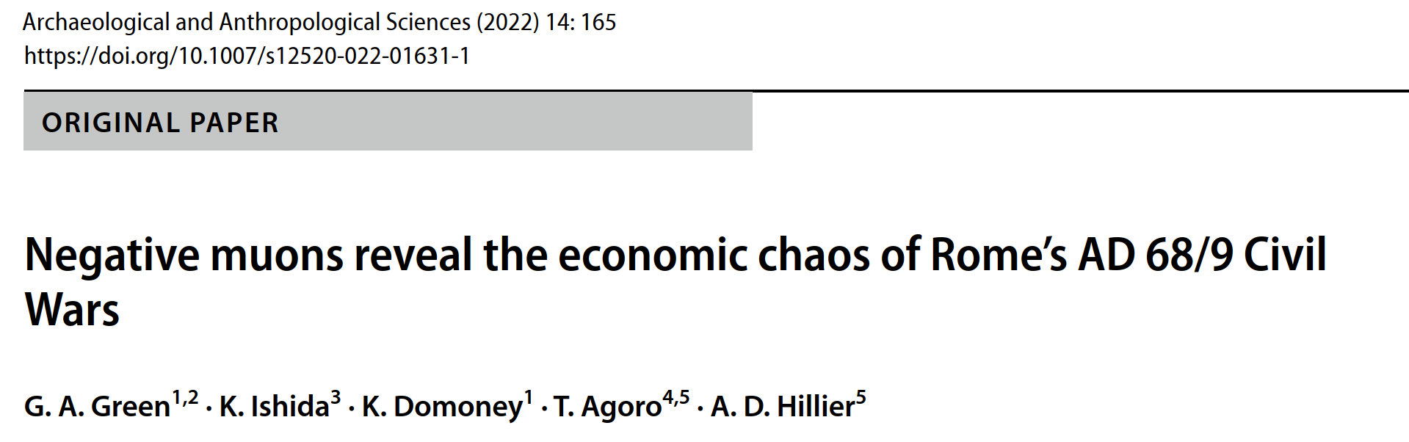
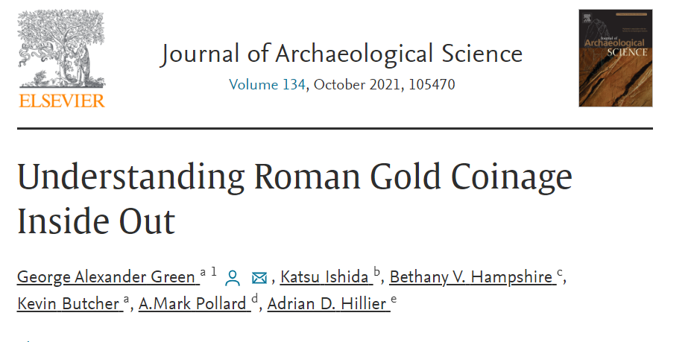
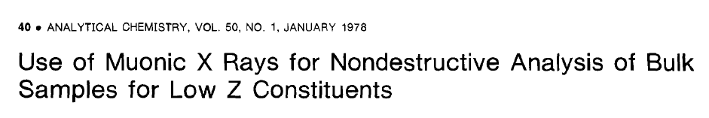
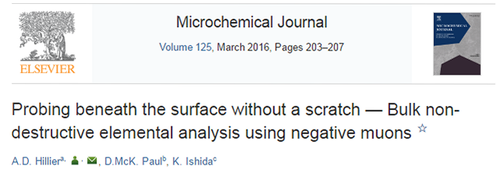
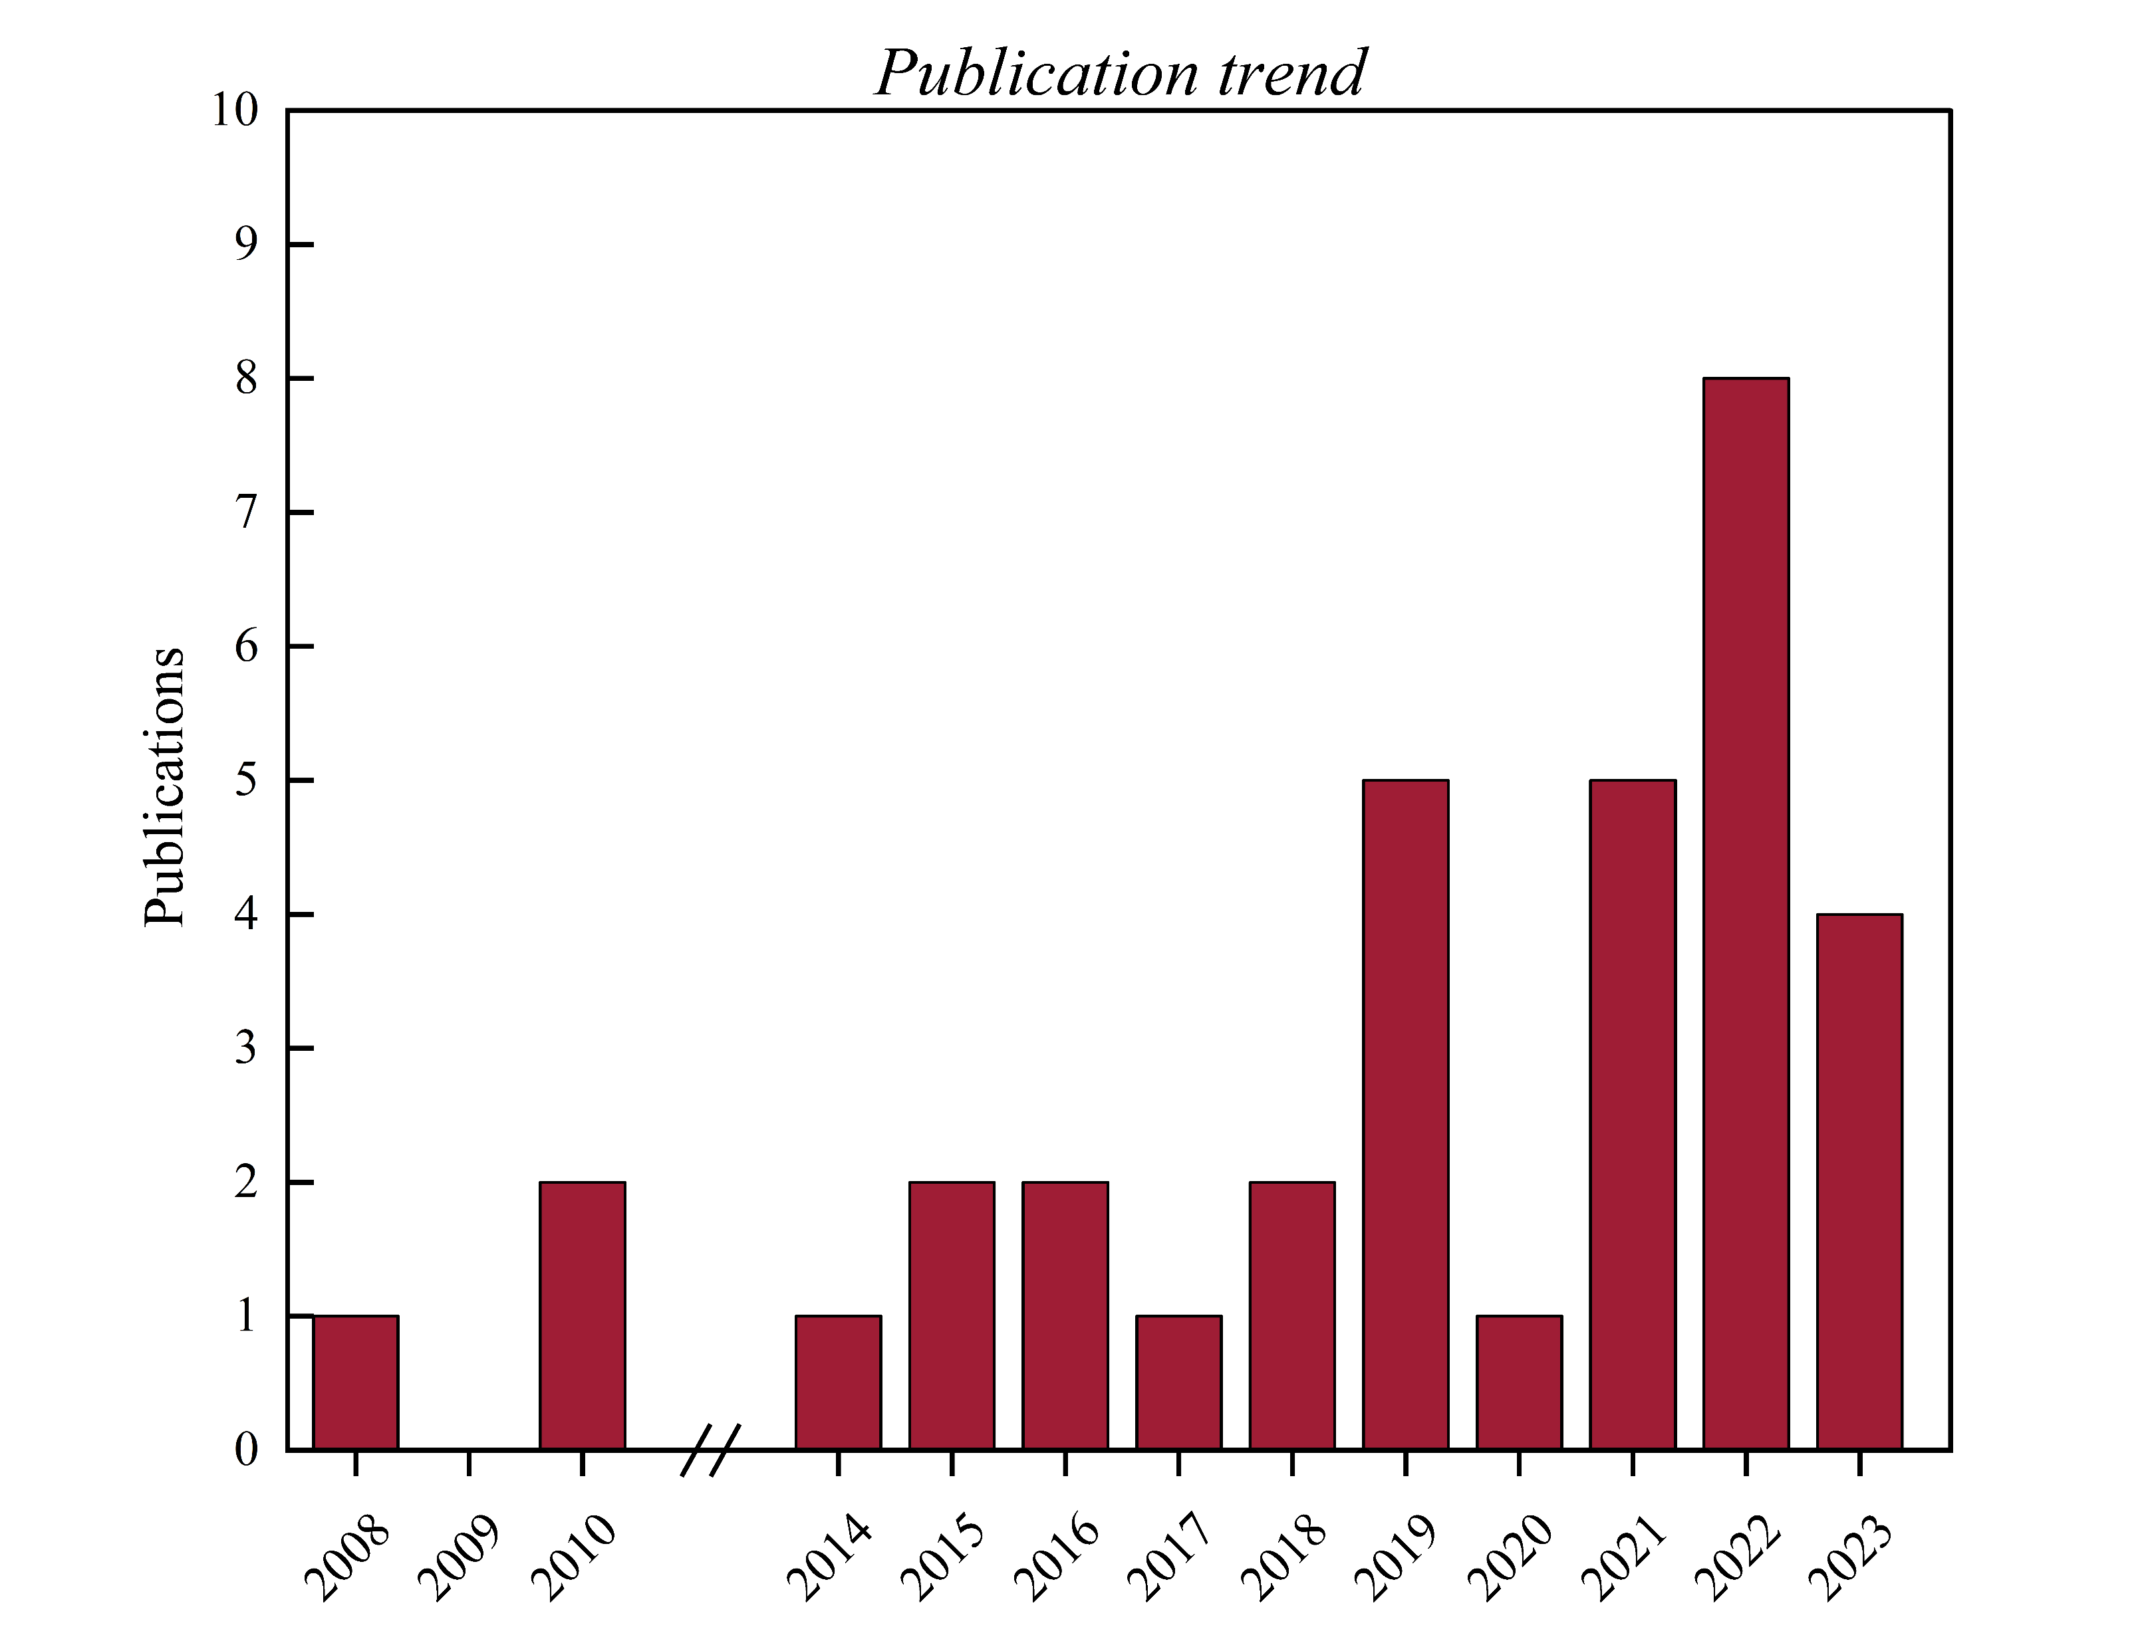
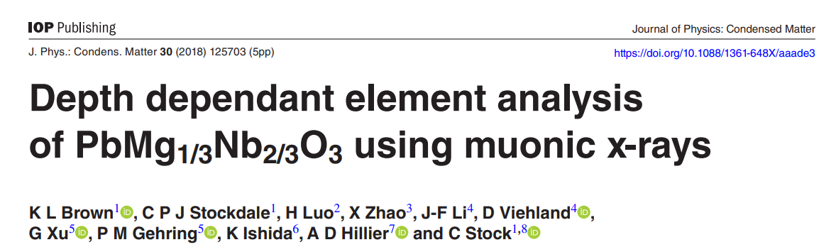
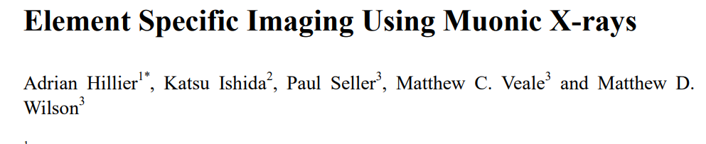
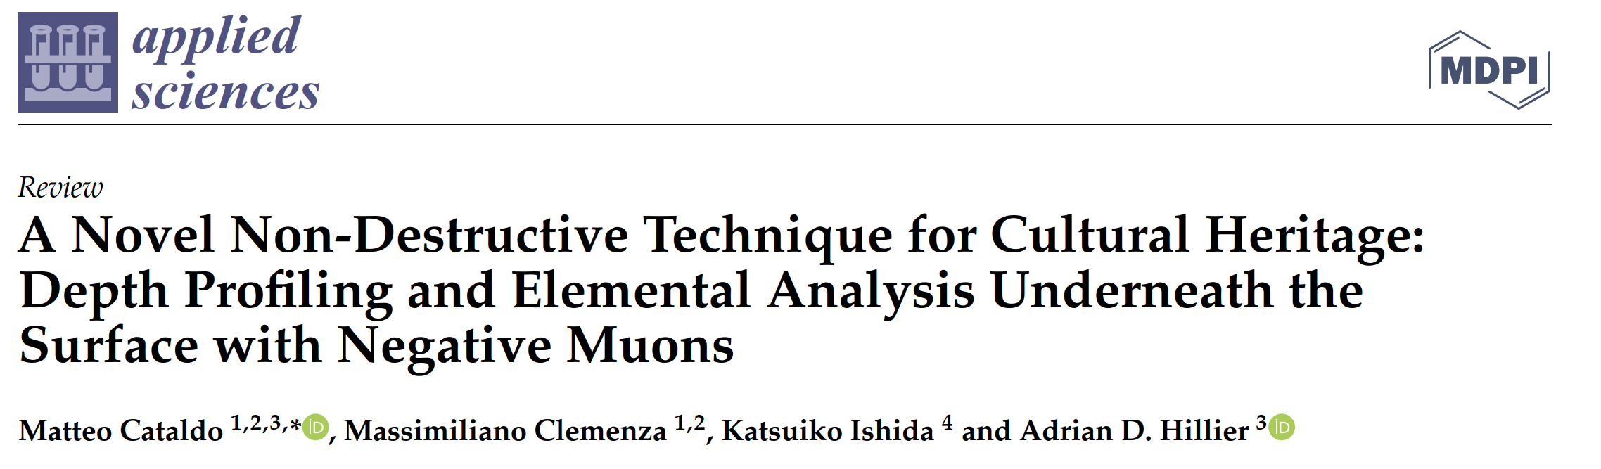
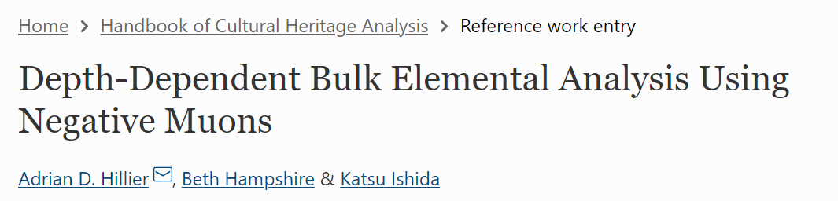
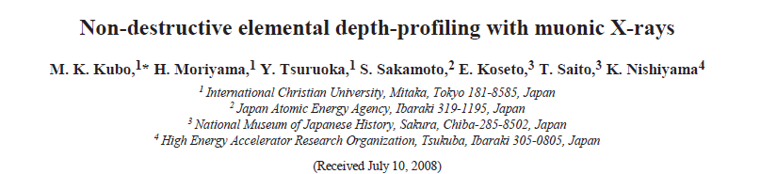
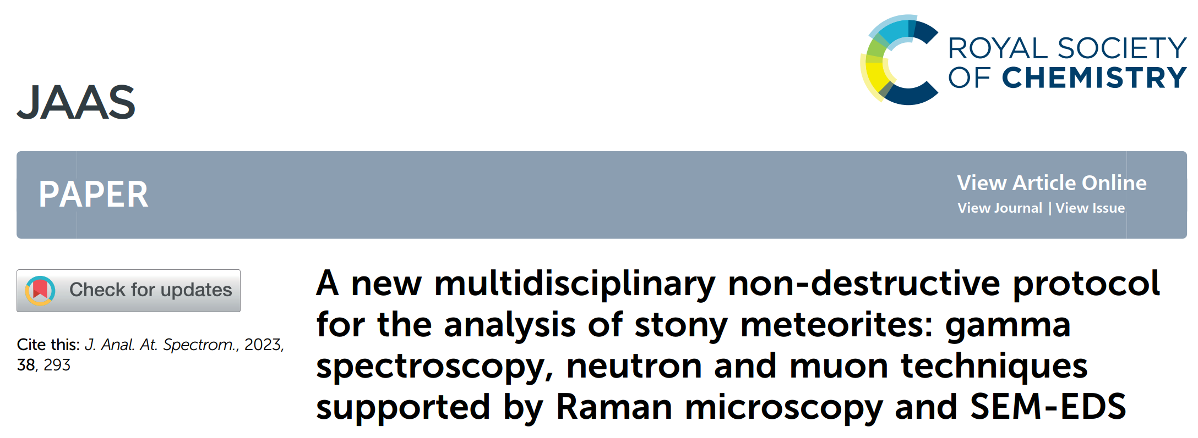
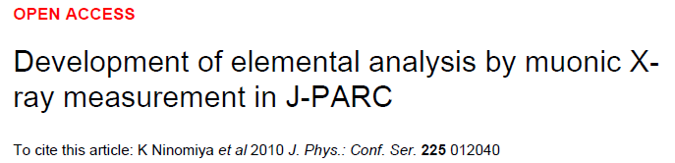
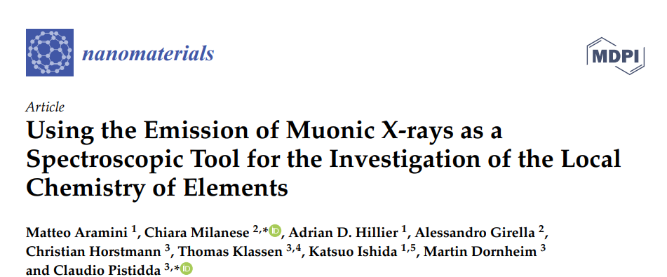
8
M. Cataldo – Negative muons for Heritage Science: background and applications, MELODY, CSNS 11/01/2025
Introduction: µ-XES – Literature (for Heritage Science)

Slide 9
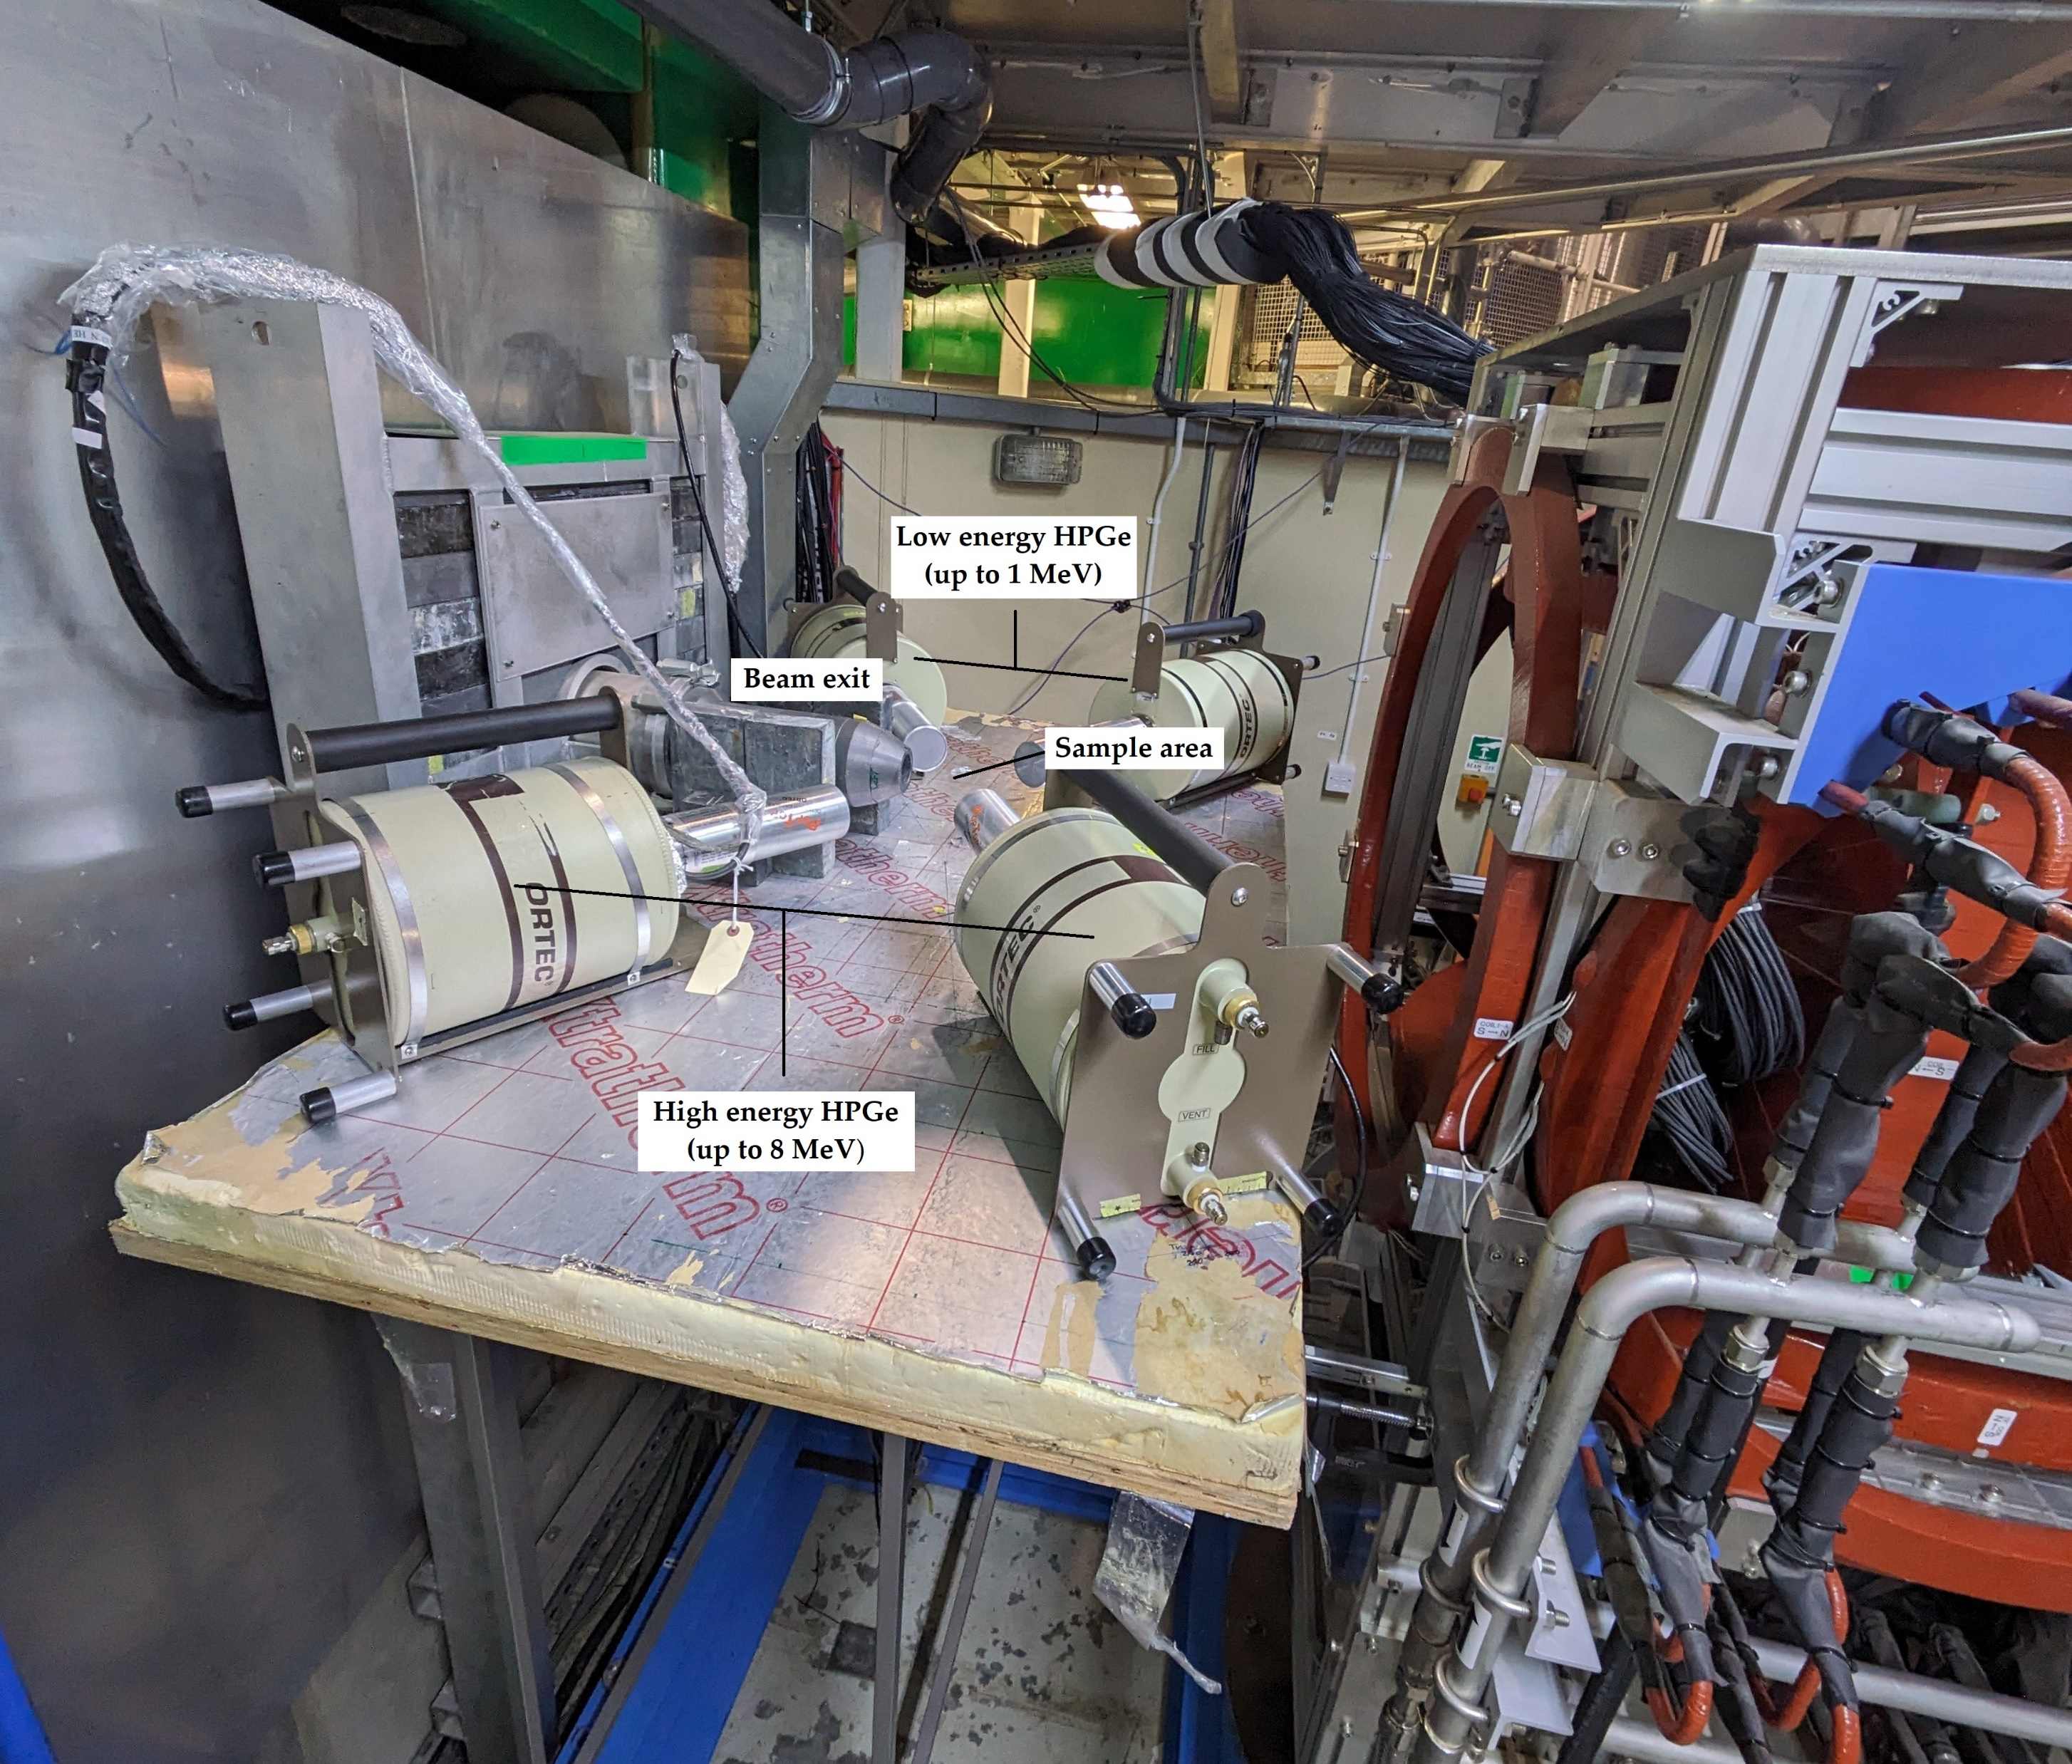
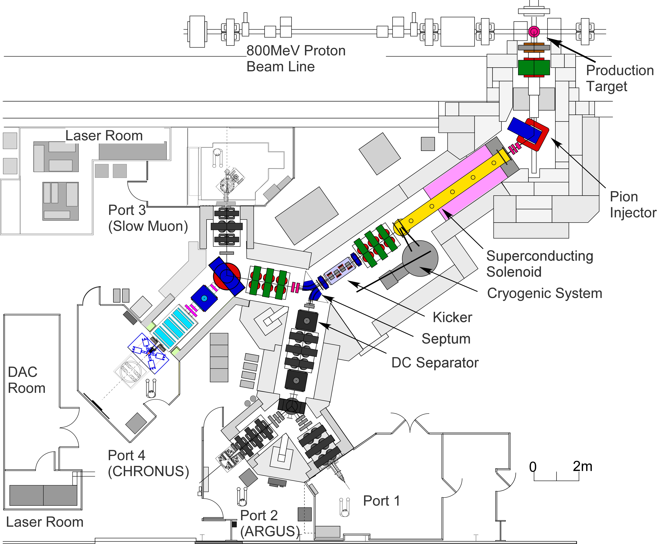
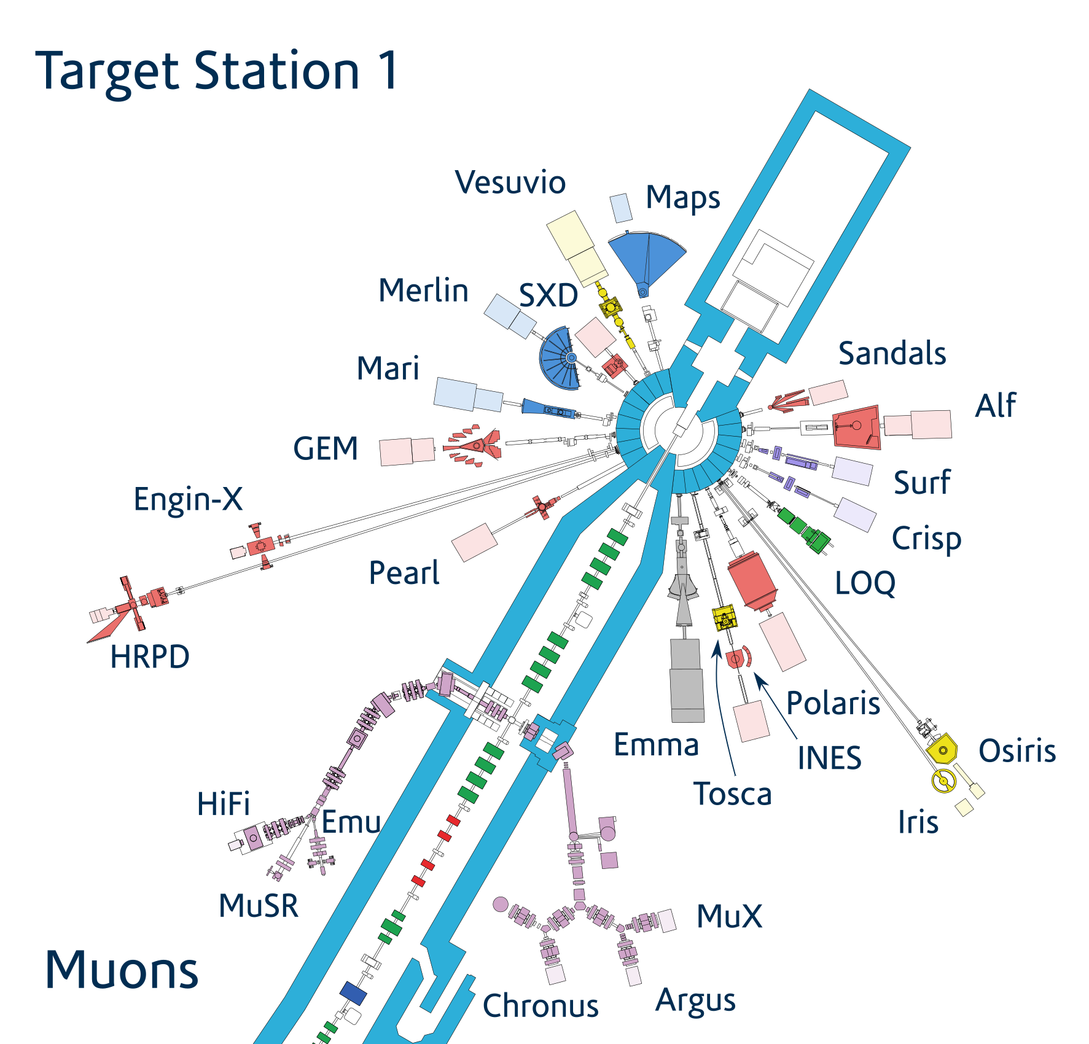
Introduction: µ-XES at ISIS
9
M. Cataldo – Negative muons for Heritage Science: background and applications, MELODY, CSNS 11/01/2025
MuX Port4 Setup @ RIKEN RAL
Notes:
Where it is performed

Slide 10
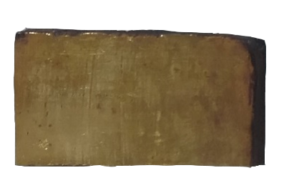
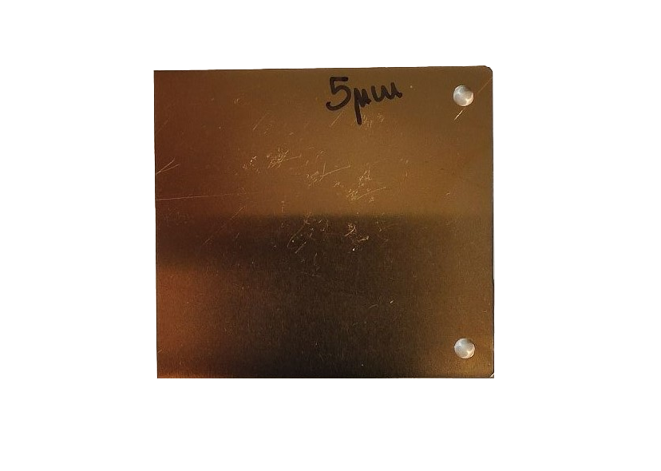
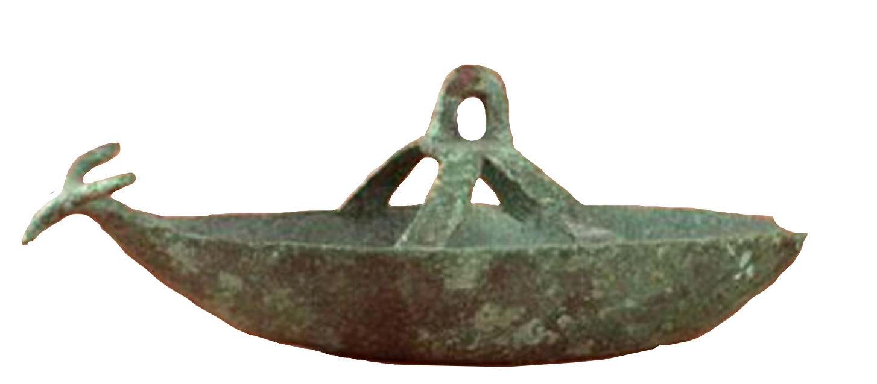
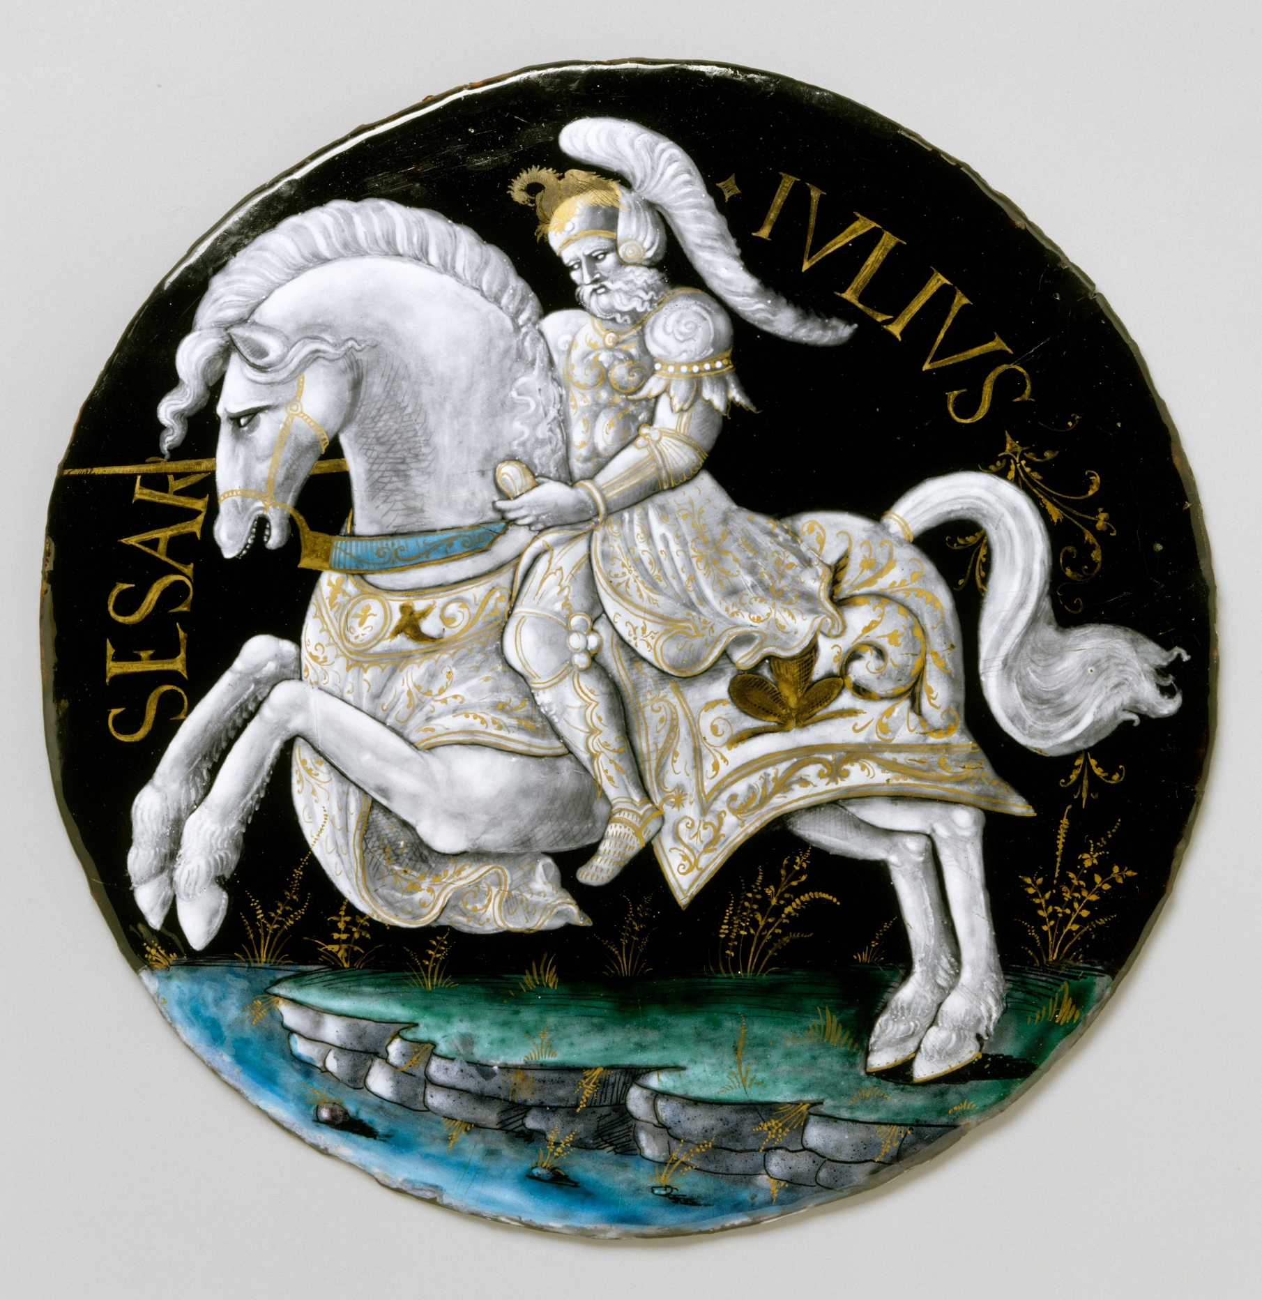
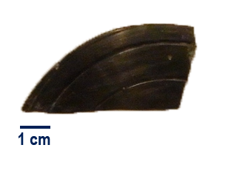
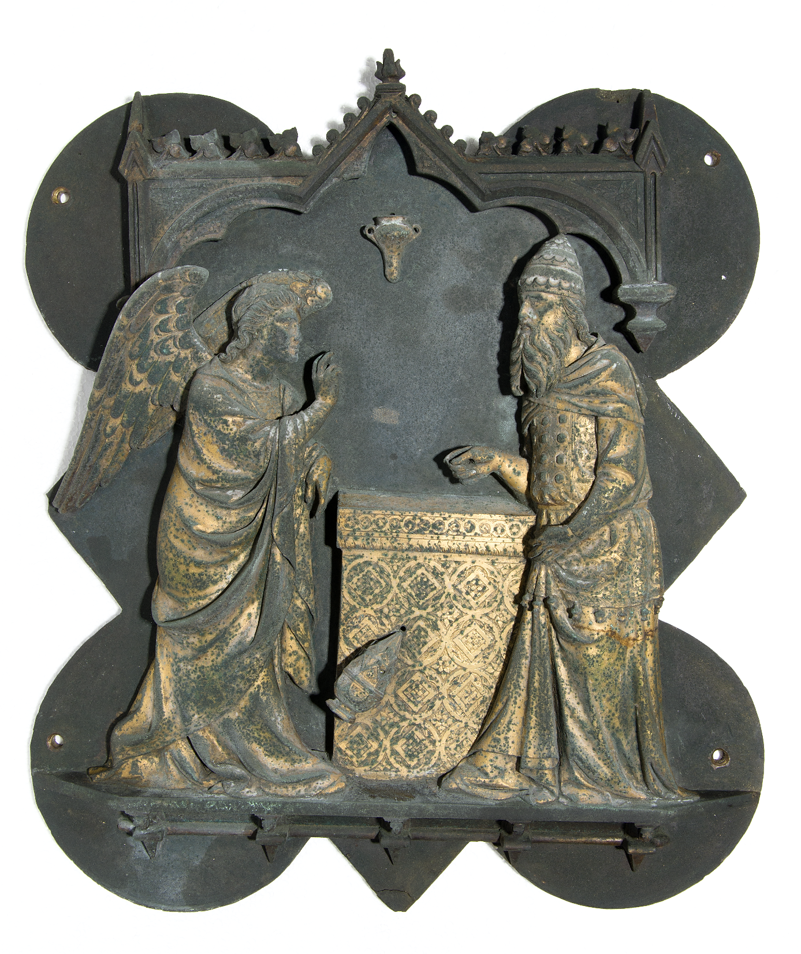
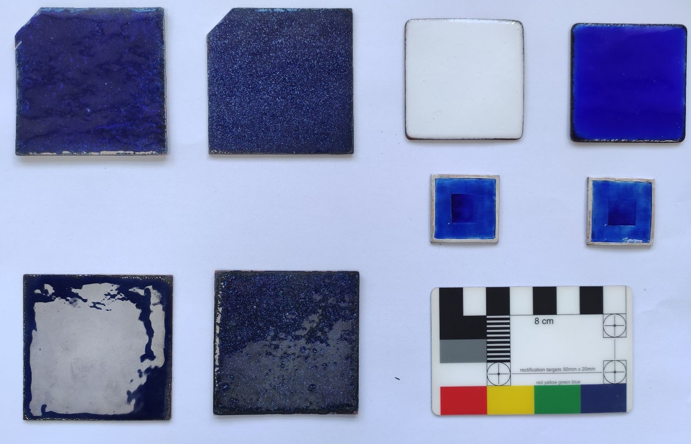
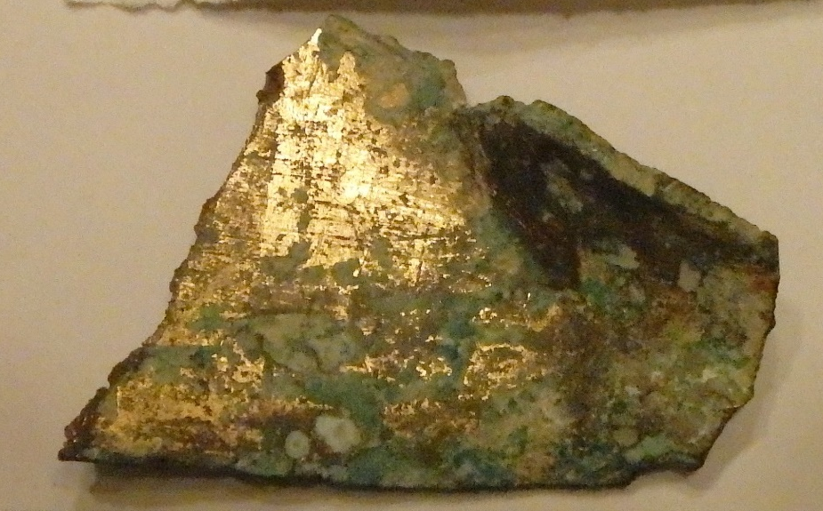
M. Cataldo, NMUSM Meeting, Warwick, 19th April 2023
10
M. Cataldo – Negative muons for Heritage Science: background and applications, MELODY, CSNS 11/01/2025
Research activities at Milano Bicocca: Archaeometry
Bronze artefacts
Enamels
Gildings

Slide 11
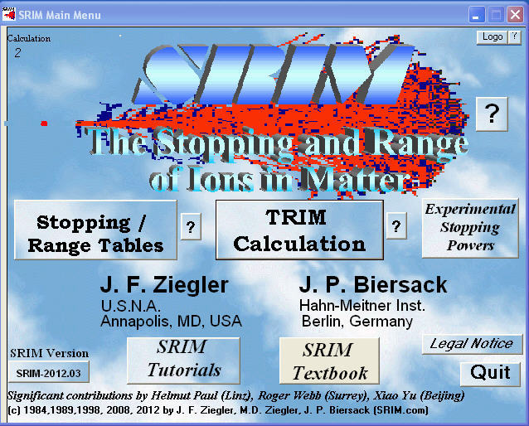

11
M. Cataldo – Negative muons for Heritage Science: background and applications, MELODY, CSNS 11/01/2025
Characterization of thin layers with negative muons
Develop a protocol for an improved interpretation of negative muon data, especially for multi-layerd artefacs
How?
By using simulation software that can be used to replicate an experiment
Software: SRIM-TRIM & GEANT4/ARBY
By comparing the result of measurement and simulation, the size of a given layer is addressed
Notes:
Main focus, started with gold now with enamels
Over the years, experiments were performed without a clear idea from users on how to use the collected data (and a PhD student that worked on the anlaysis )

Slide 12
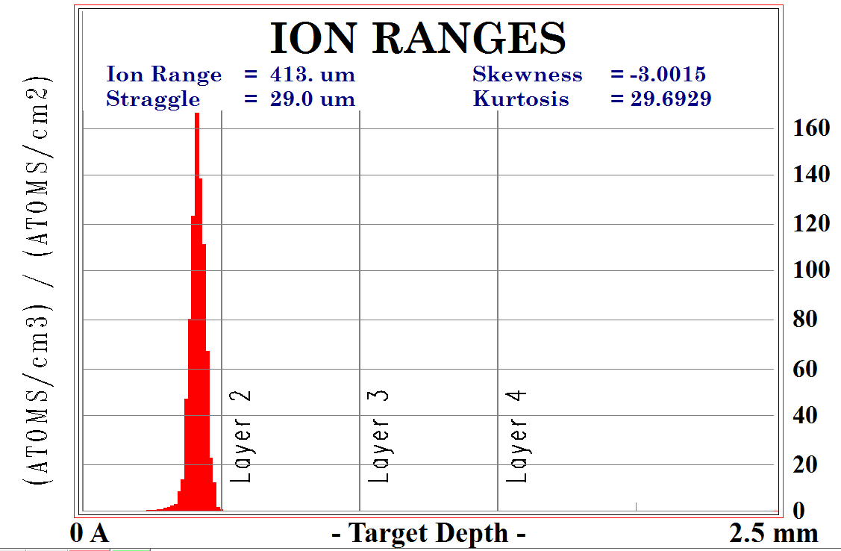
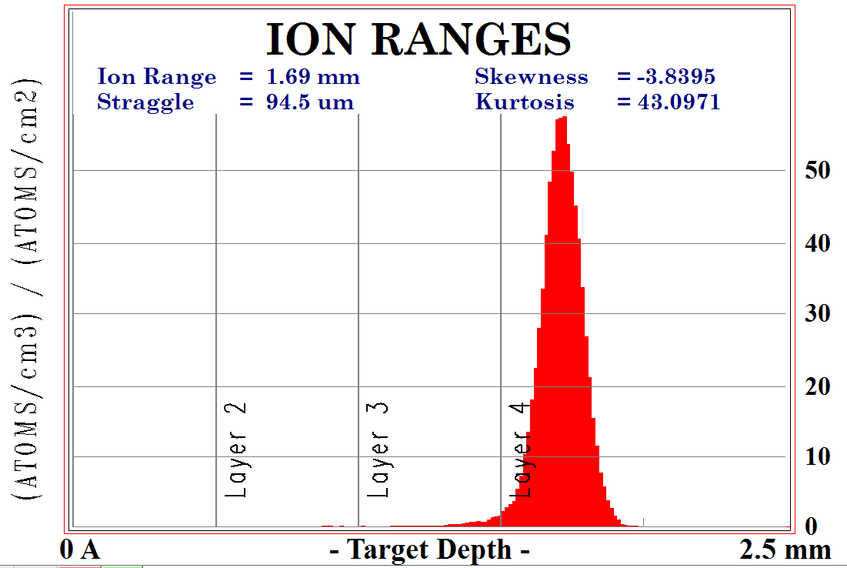
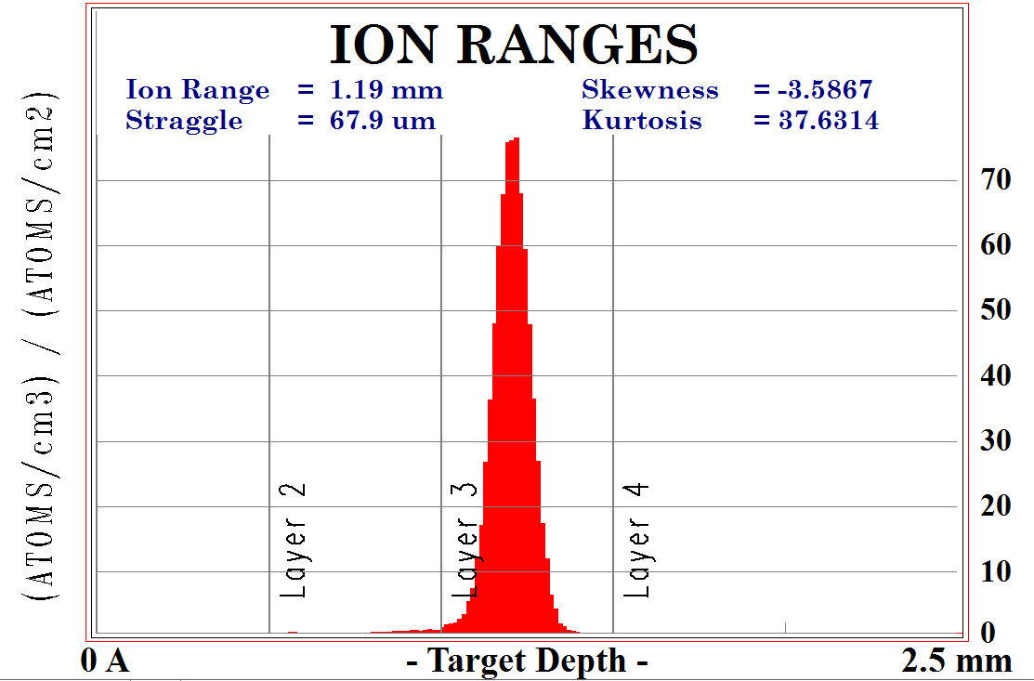
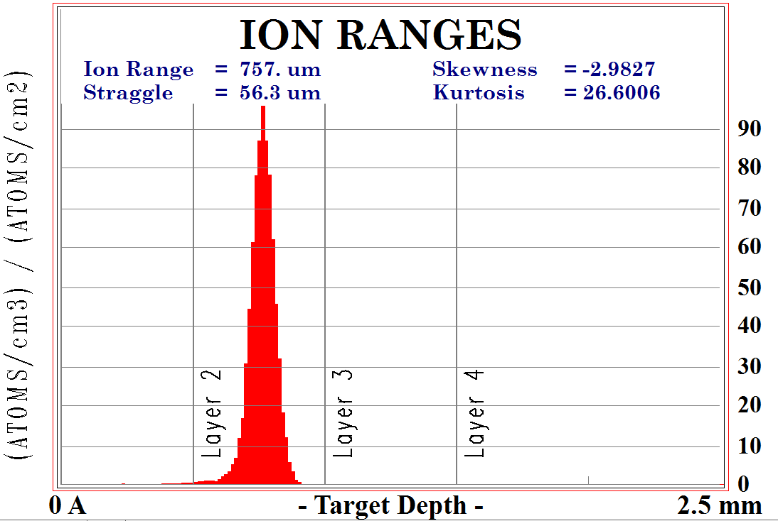
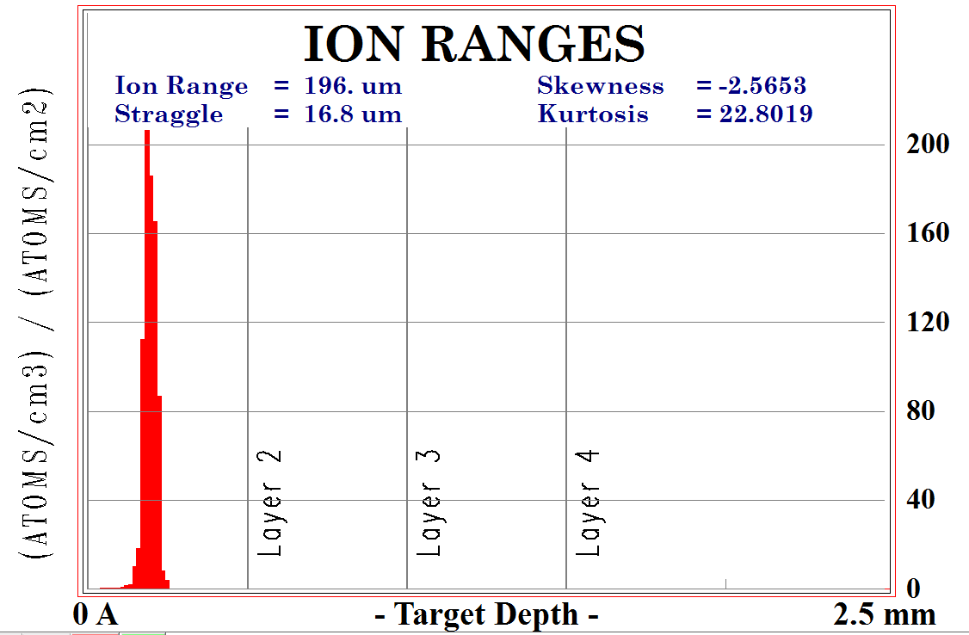
12
M. Cataldo – Negative muons for Heritage Science: background and applications, MELODY, CSNS 11/01/2025
Characterization of thin layers with negative muons

Slide 13
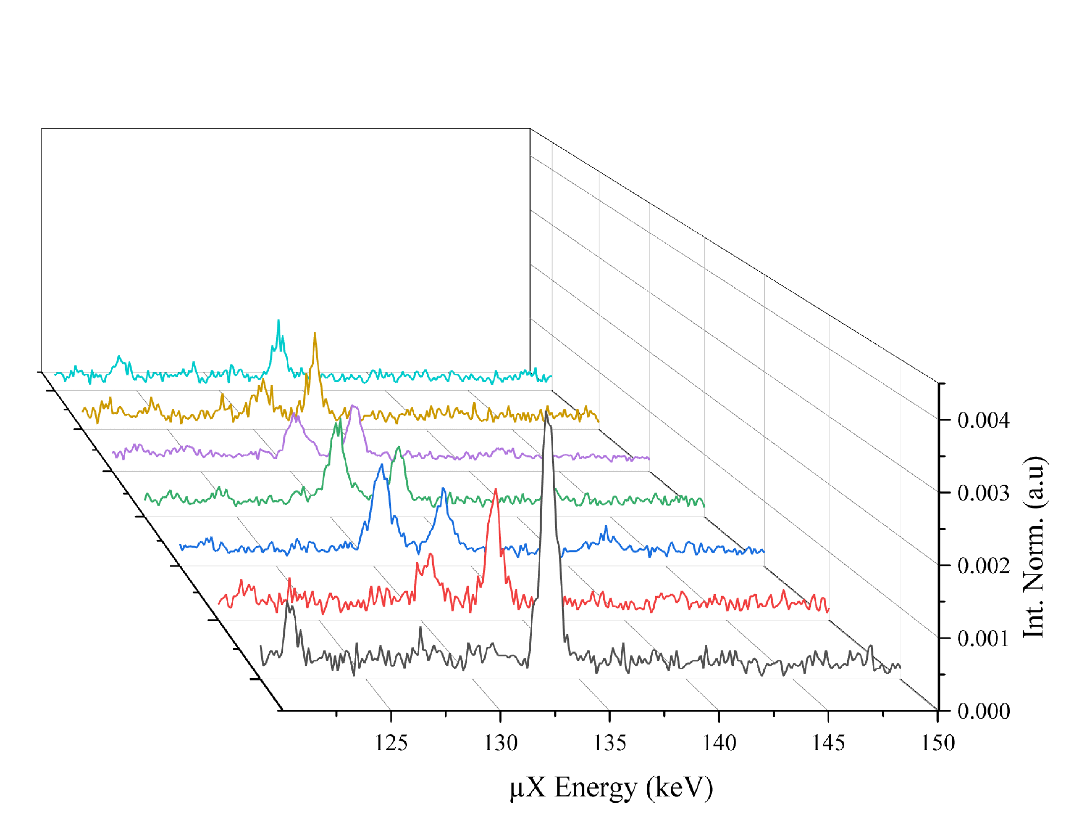
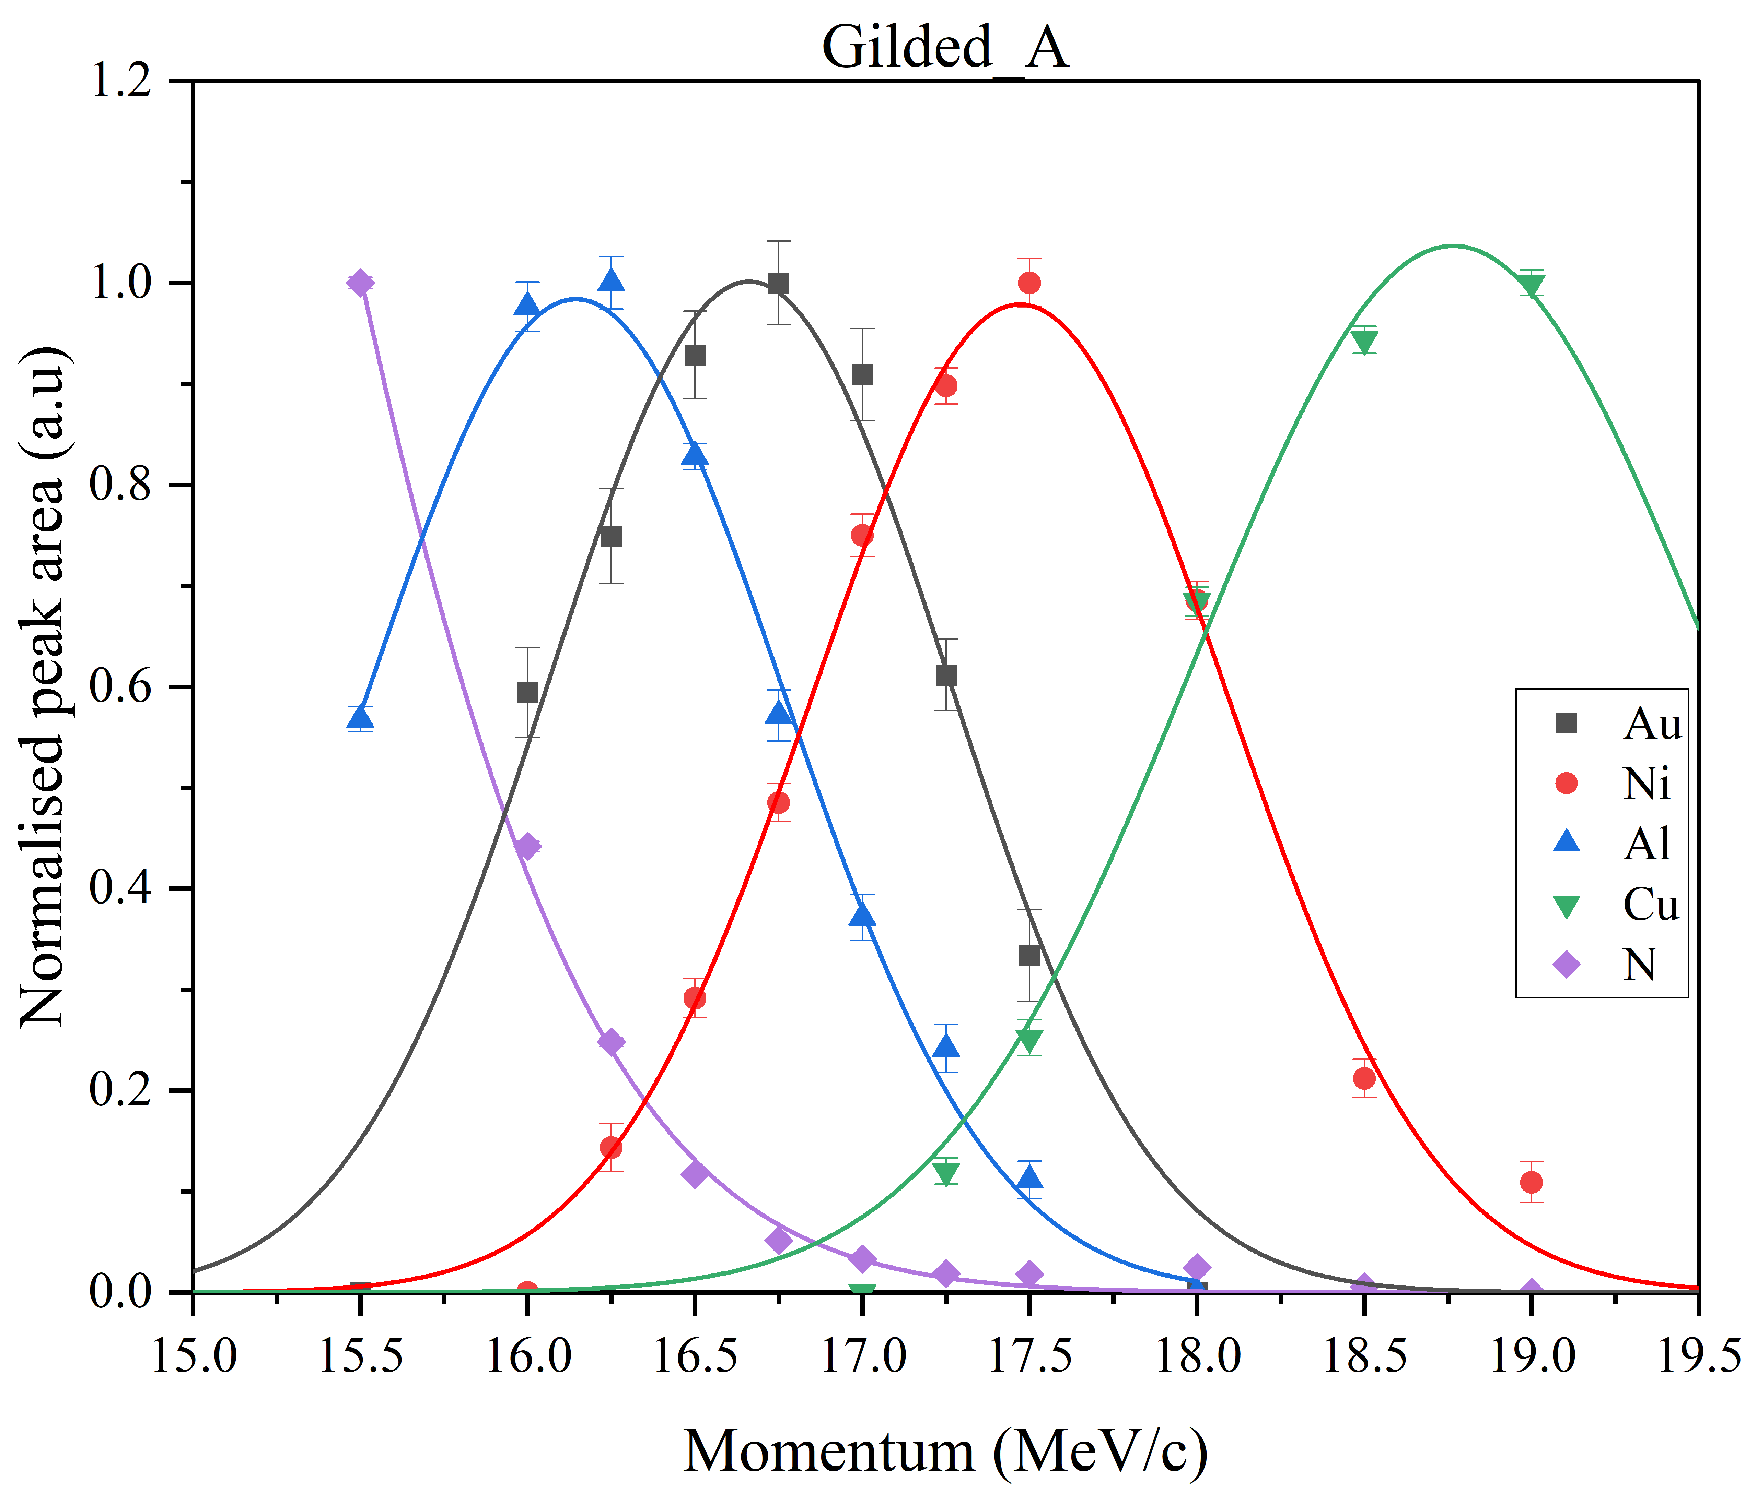
13
M. Cataldo – Negative muons for Heritage Science: background and applications, MELODY, CSNS 11/01/2025
Characterization of thin layers with negative muons
The intensity of the X-rays varies as the muon beam momentum changes
From that, the variation of the composition of the layer is reconstructed
To finally give a
depth profile

Slide 14
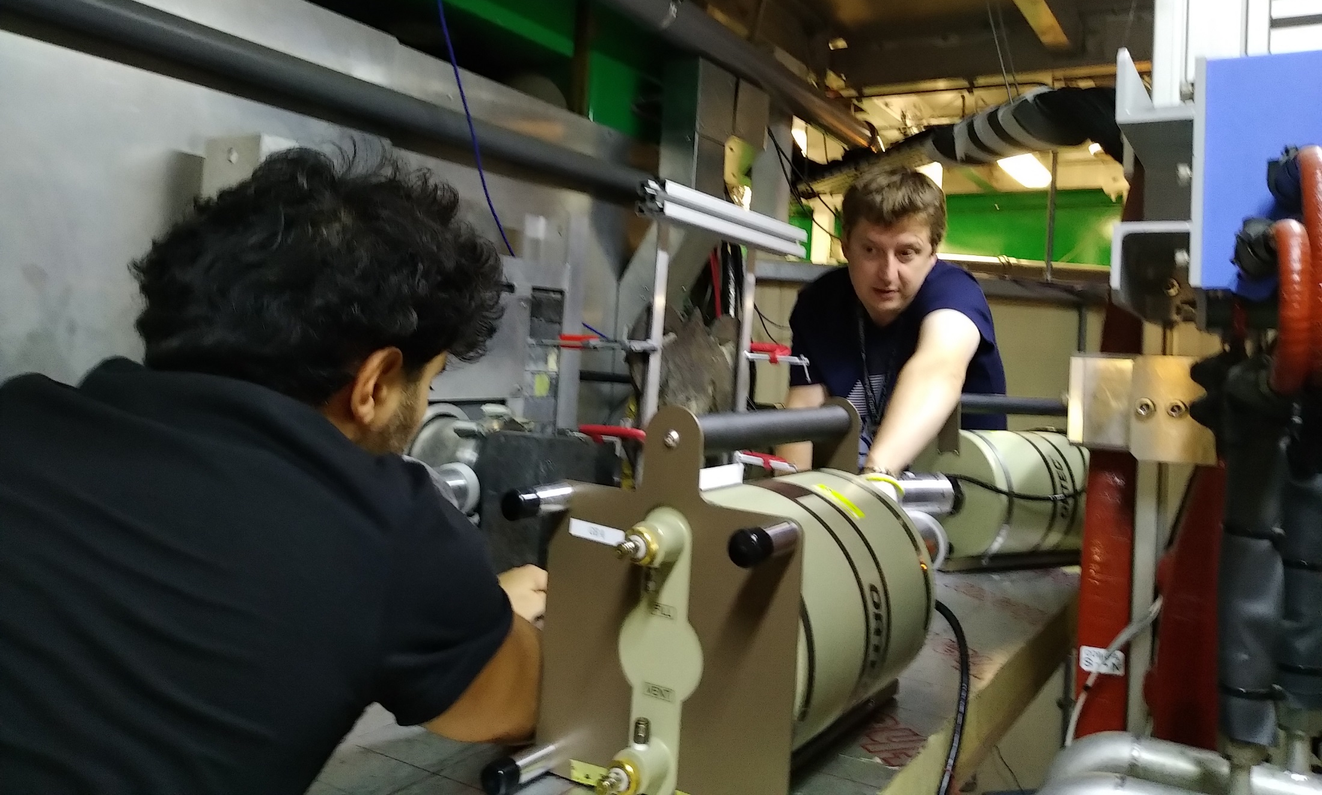
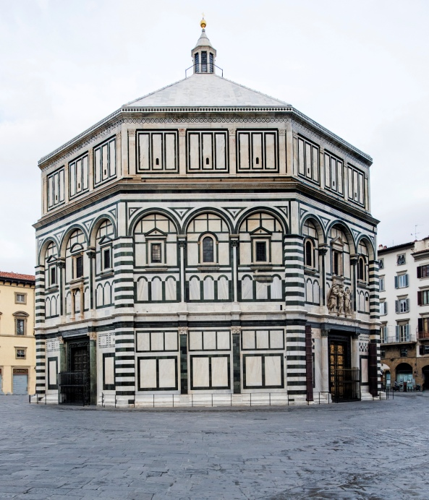
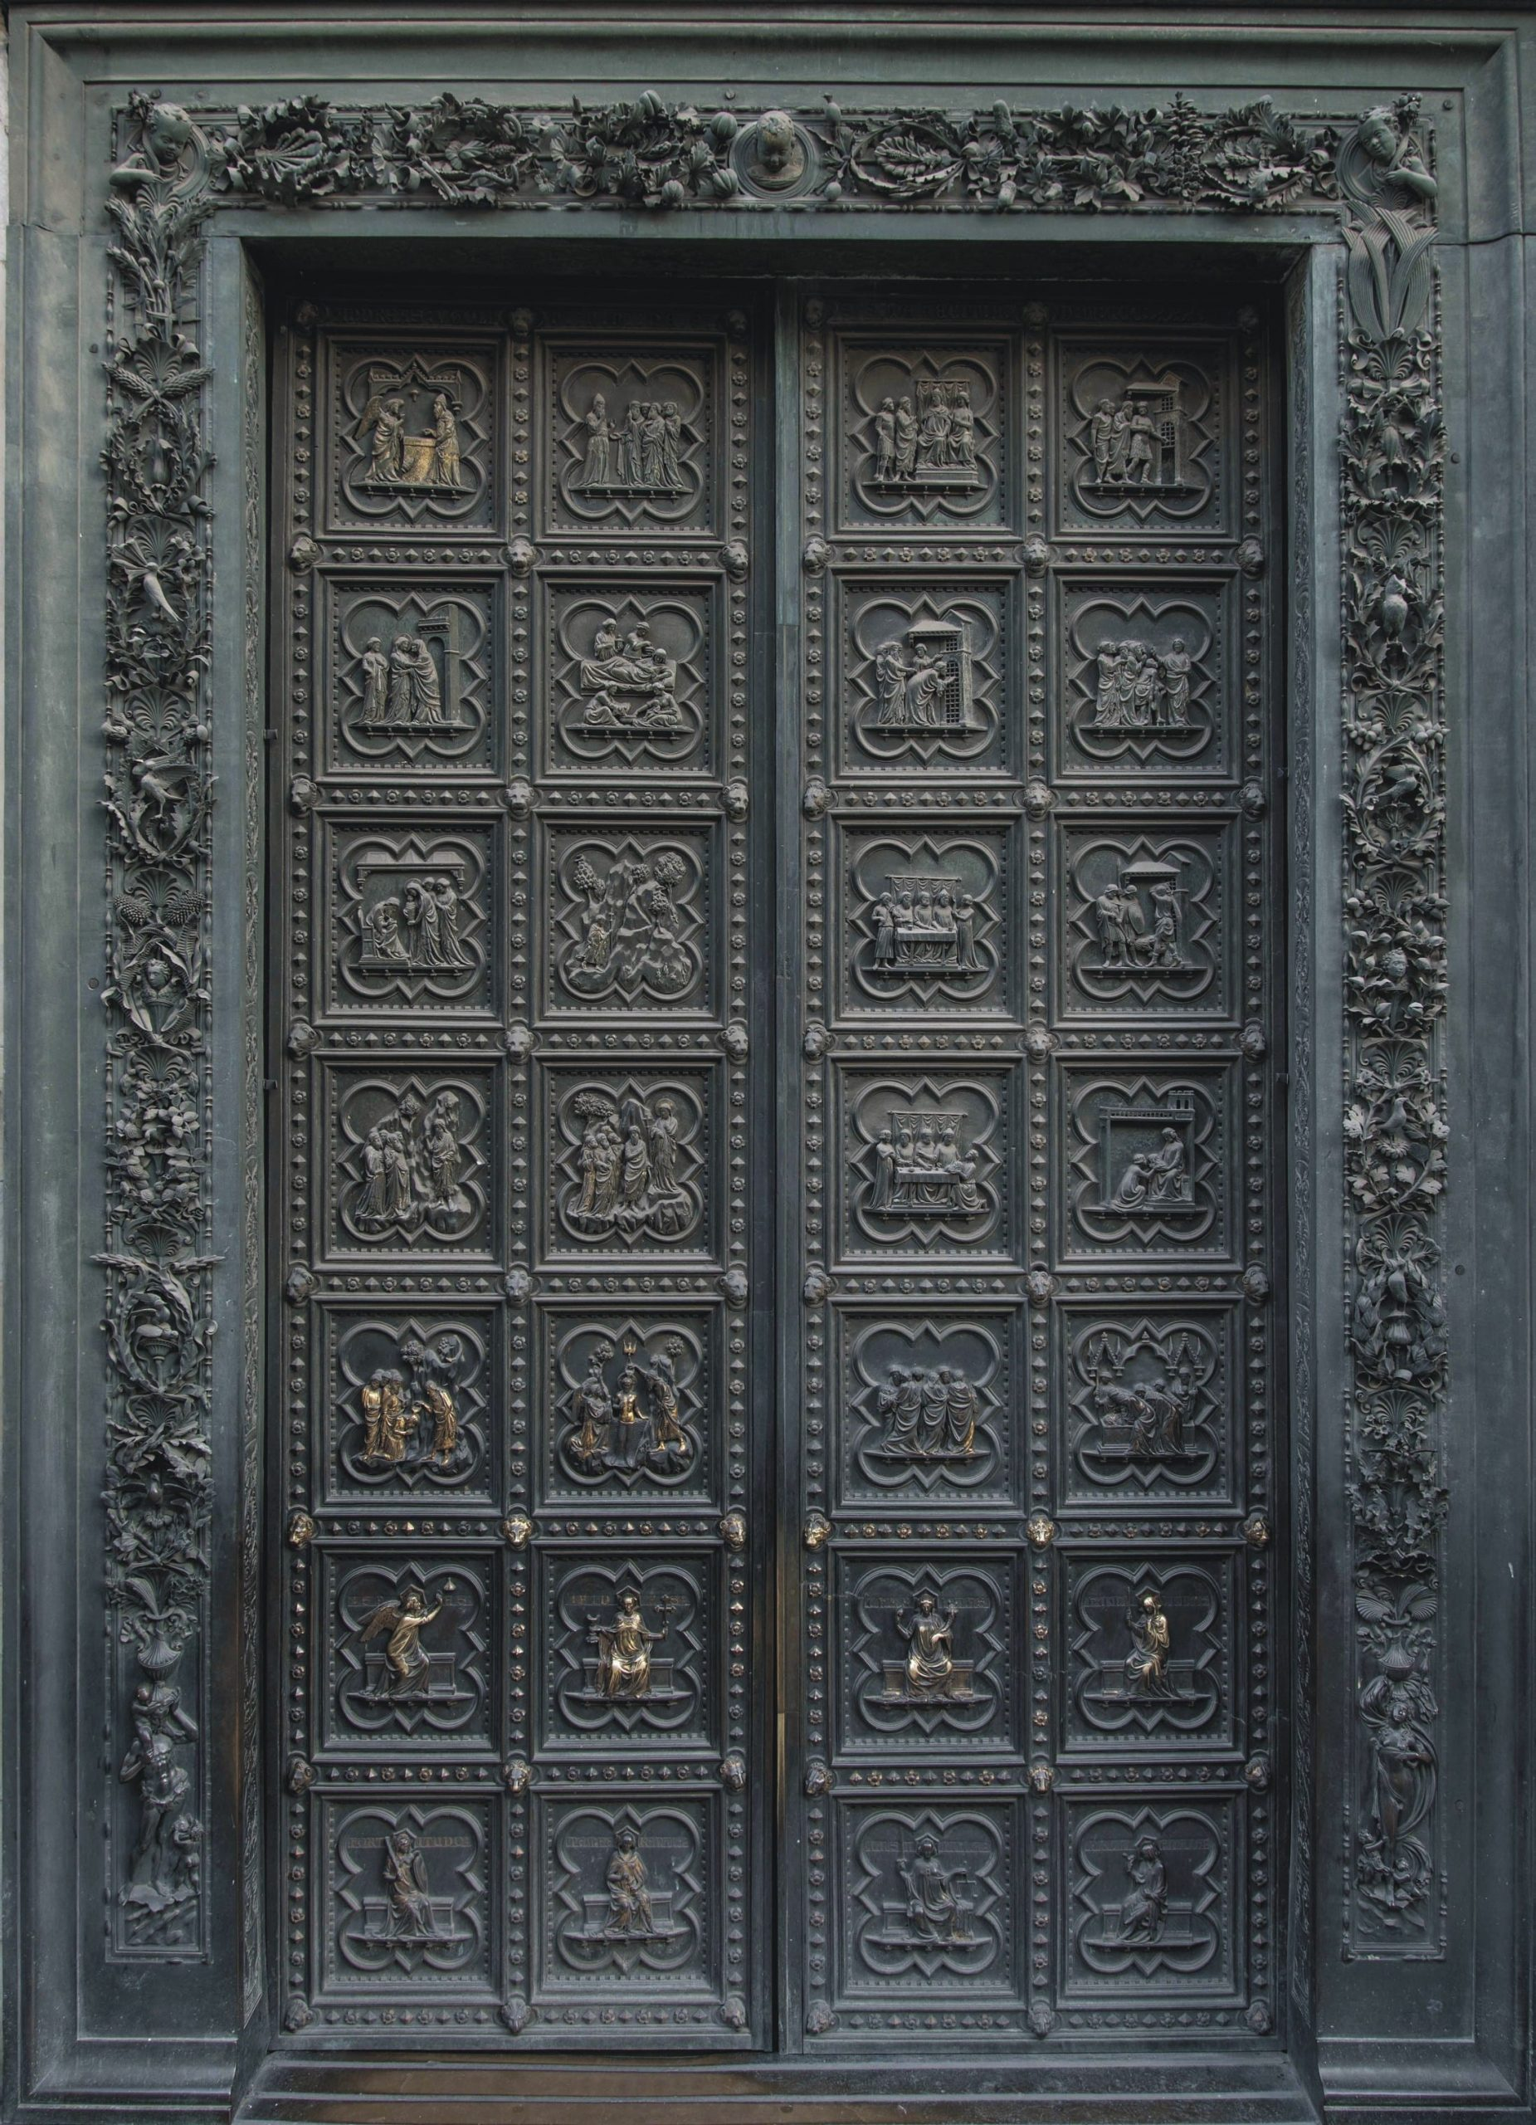
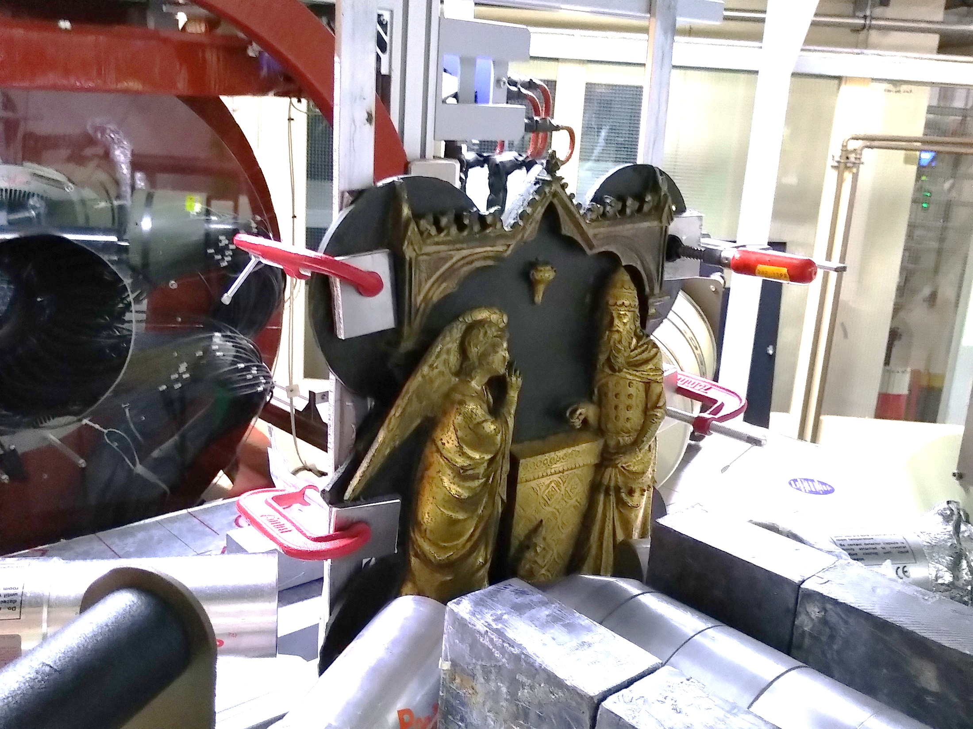
14
M. Cataldo – Negative muons for Heritage Science: background and applications, MELODY, CSNS 11/01/2025
Characterization of thin layers: gildings

Slide 15
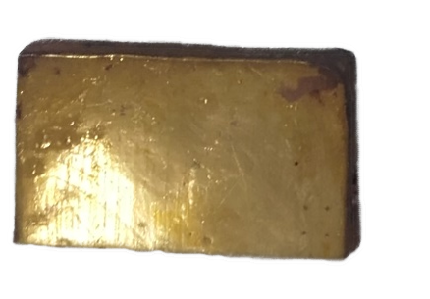
15
M. Cataldo – Negative muons for Heritage Science: background and applications, MELODY, CSNS 11/01/2025
Characterization of thin layers: gildings
Validation process: from mockup samples to a real bronze sample
Mockup sample
(dimensions:5cmx5cmx0.0005cm)
Mockup sample
Top: SM3, Bottom: EM2
(dimensions:.5cmx2.5cmx0.5cm)
«Annunciation to Zachary» Andrea Pisano, Leonardo D'Avanzo e bottega (1329 -1336)
(Courtesy of F. Cantini – CNR-IFAC)

Slide 16
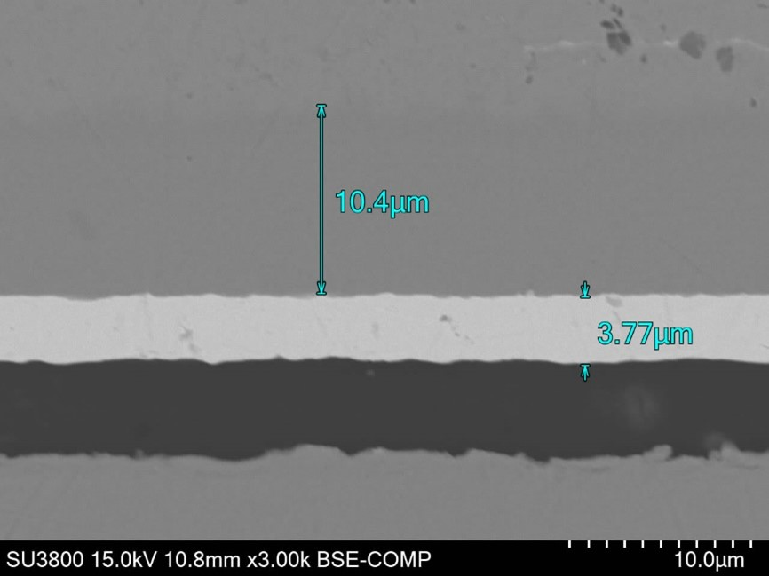
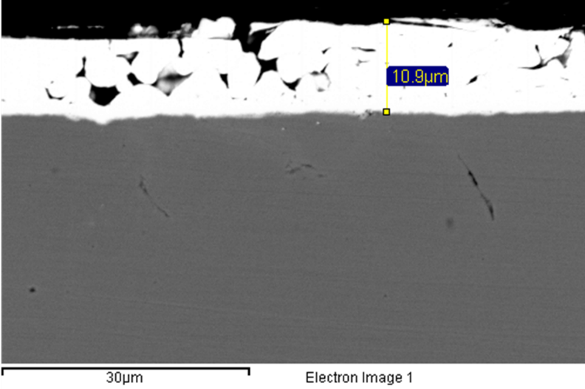

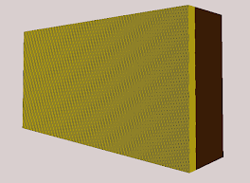
16
M. Cataldo – Negative muons for Heritage Science: background and applications, MELODY, CSNS 11/01/2025
Characterization of thin layers: gildings
Validation process: from mockup samples to a real bronze sample
10.4 µm
3.7 µm

Slide 17




17
M. Cataldo – Negative muons for Heritage Science: background and applications, MELODY, CSNS 11/01/2025
Characterization of thin layers: gildings
Sample A
Average gold thickness form SEM: 3.3 ± 0.2 μm
Measured gold thickness: 3.5 ± 0.5 μm

Slide 18


18
M. Cataldo – Negative muons for Heritage Science: background and applications, MELODY, CSNS 11/01/2025
Characterization of thin layers: gildings
Sample C
Average gold thickness form SEM: 7.3 ± 0.8 μm
Measured gold thickness: 7.5 ± 0.5 μm

Slide 19



19
M. Cataldo – Negative muons for Heritage Science: background and applications, MELODY, CSNS 11/01/2025
Characterization of thin layers: gildings
Angel body: gold thickness of 16 ± 0.5 μm
Zachary body: gold thickness of 15 ± 0.5 µm
Lion: gold thickness of 15 ± 0.5 µm
Good control of the process gilding process

Slide 20
20
M. Cataldo – Negative muons for Heritage Science: background and applications, MELODY, CSNS 11/01/2025
Characterization of thin layers: Enamels
Painted enamels: preliminary study on mockup samples
Notes:
APPLY SAME APPROACH TO OTHER MATERIALSThe city of Limoges, in the south-west of France, has been the centre of production of enamels since the Middle Ages. Enamels consist of thin layers of glass, coloured by a metallic compound fused on a metal surface. Their quality was so fine that they were compared to paintings: a copper layer as a canvas and the glass as the paint, representing mostly mythology and religion scenes (Figure 1). The production covered three centuries, from XV to XVII, with a renewed interest in the XIX century. Enamels can be manufactured using different techniques (champlevé or cloisonné for example) but what is peculiar of the Limoges painted enamels, is that they are characterized by a multi-layered structure, done by consecutive firing steps. The colour was guaranteed by the presence of different chromophores, apart from the “en grisaille” technique, were only black and white was used.

Slide 21

21
M. Cataldo – Negative muons for Heritage Science: background and applications, MELODY, CSNS 11/01/2025
Characterization of thin layers: Enamels
Enamels represent a challenge for conservation scientists:
Very fragile artefacts: sampling could cause damage and should be avoided
Layers can be in the order of the hundreds of microns
The glass can be altered on the surface: muons could provide quantitative information from the bulk of the material
Alteration
µXES could be one of the only techniques that can probe beneath the surface and perform a non-destructive quantitative analysis of painted glasses.

Slide 22



22
M. Cataldo – Negative muons for Heritage Science: background and applications, MELODY, CSNS 11/01/2025
Characterization of thin layers: Enamels
Preliminary results (beamtime @ISIS in October 2024)
PRELIMINARY
PRELIMINARY

Slide 23


23
M. Cataldo – Negative muons for Heritage Science: background and applications, MELODY, CSNS 11/01/2025
Research activities at Milano: facility development
CHNet-MAXI (Muonic Atom X-ray spectroscopy for Isotopic analysis) project: aims at developing a reliable system for isotopic analysis with µ-XES for cultural heritage (2023-2025 purposes.
Main features:
A muon beam hodoscope to be used as a beam x/y profiler and a beam intensity monitor
A set of scintillating detectors read by SiPM for a compact detection system (GAGG and CLLB)
Array of 9 Hpge and customized acquisition system based on CAEN Digitizers

Slide 24
M. Cataldo – Negative muons for Heritage Science: background and applications, MELODY, CSNS 11/01/2025
Conclusions & future work
µ-XES has unique characteristics among the many other elemental technique in the field of cultural heritage:
    Sensitive to (almost) all elements
    Depth selective
    Non-destructive
Combined with Monte Carlo simulations, Muonic X-ray spectroscopy can be used to address the size of thin layers in materials.
This approach is still a work in progress, but results are promising. In the future I will continue the work with enamels and to improve the capabilities of thesimulation software .
谢谢各位的聆听!

Slide 25





M. Cataldo – Negative muons for Heritage Science: background and applications, MELODY, CSNS 11/01/2025
Characterization of thin layers: gildings
$$χ_{r}^{2}=2.60$$
$$χ_{r}^{2}=2.40$$
$$χ_{r}^{2}=1.23$$
For the SM3 sample, the results are in agreement with the measurements but also with the SEM results (11 ± 0.5 μm). While for the EM2 sample, a different thickness has been evaluated (5 ± 0.5 μm).

Slide 26

M. Cataldo – Negative muons for Heritage Science: background and applications, MELODY, CSNS 11/01/2025
Research activities at Milano: facility development

